Slide 1
Intermediate Statistics
Lectures 7-8: Linear Regression
February 28 and March 13, 2024
HAD5772 • Alex Hoagland, Ph.D.

Slide 2

Last Time
Data visualization is a powerful tool: use it well
Measuring correlations and covariances (but not causation – yet!)
Quantifying (some) uncertainty: standard deviations
This Time
Quantifying (more) uncertainty
Standard errors
Confidence Intervals

Slide 3
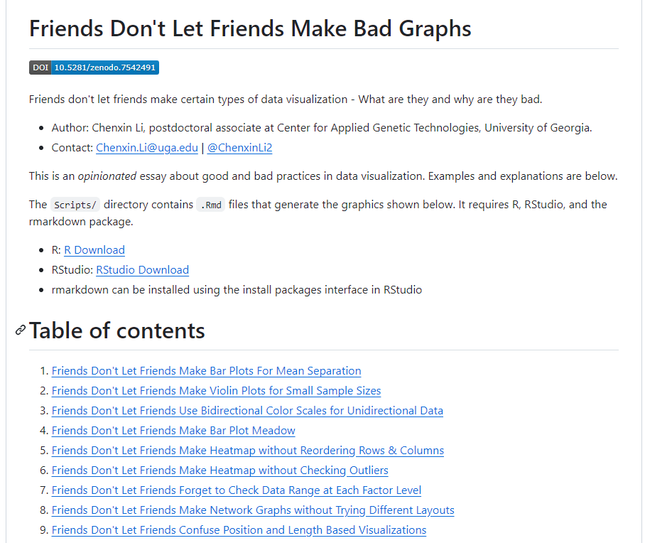
But first
Notes:
https://github.com/cxli233/FriendsDontLetFriends

Slide 4
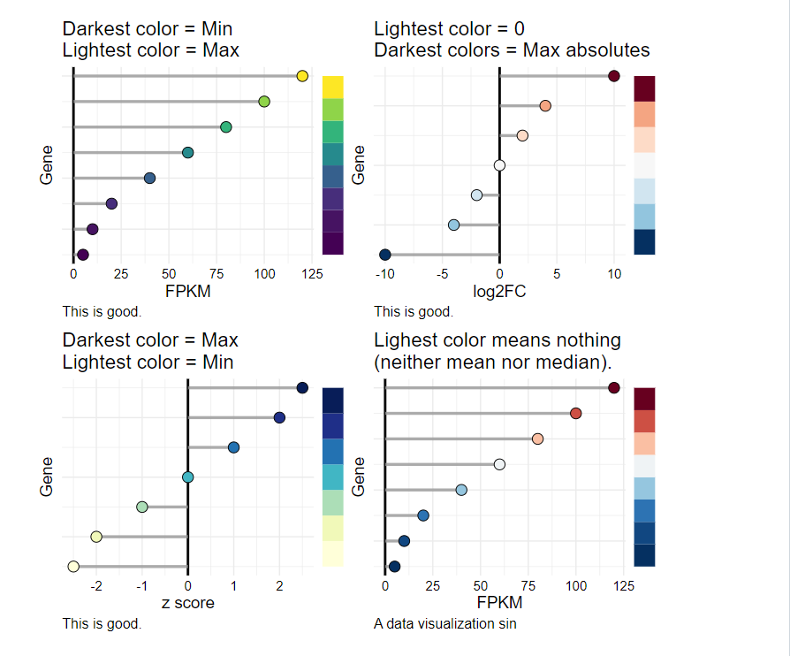
But first
Notes:
https://github.com/cxli233/FriendsDontLetFriends. Another source: https://vciba.springeropen.com/articles/10.1186/s42492-021-00092-y.

Slide 5
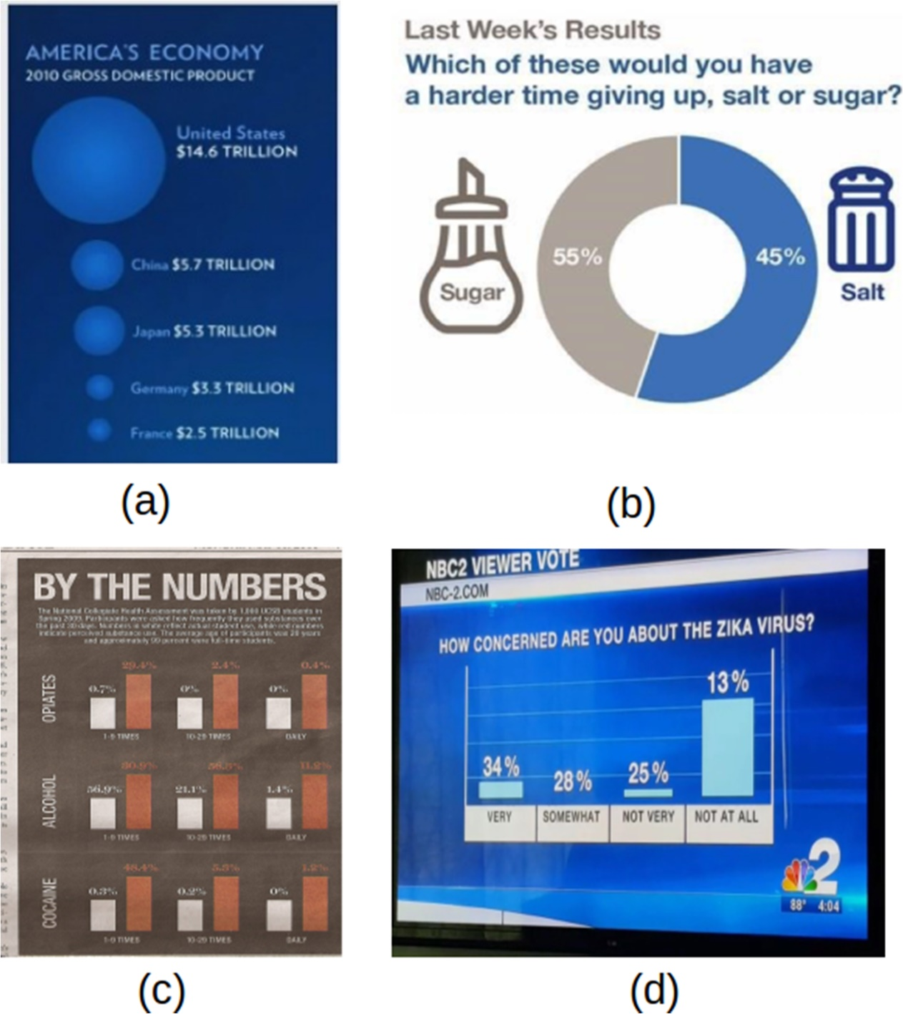
But first
Notes:
https://vciba.springeropen.com/articles/10.1186/s42492-021-00092-y. What’s happening? a using wrong scale [43], b size is inverted [40], c all sizes are equal [44] and d size with no meaning [45]

Slide 6
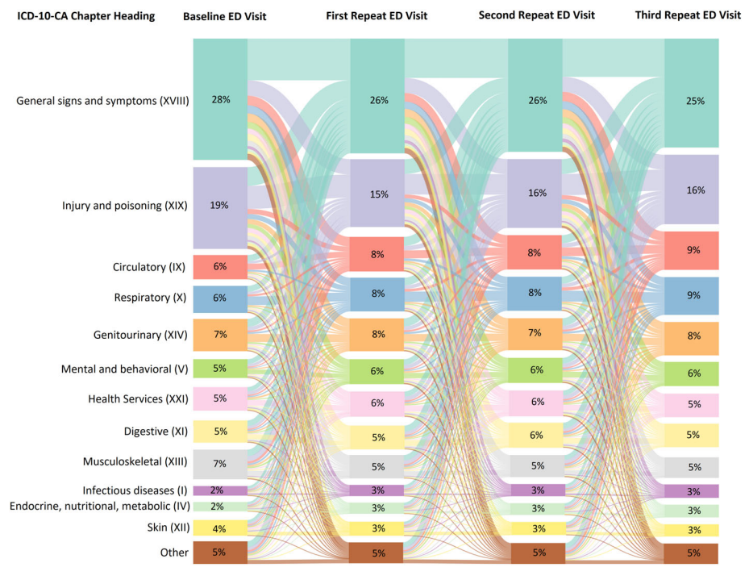
But first
Notes:
Source: https://agsjournals.onlinelibrary.wiley.com/doi/pdfdirect/10.1111/jgs.17726

Slide 7


But first: Interactive visualizations
Tableau
R Shiny
Notes:
https://public.tableau.com/app/profile/jawad.chishtie/viz/InteractiveVisualizationApplicationsinPopulationHealthandHealthServicesResearch-Jan2005toMarch2019/DataSource
Shiny publication: https://journals.plos.org/plosone/article?id=10.1371/journal.pone.0266154
Shiny application: https://kelsey209.shinyapps.io/hsrdefbuilder/
Shiny code: https://github.com/kelsey209/hsrdefbuilder

Slide 8
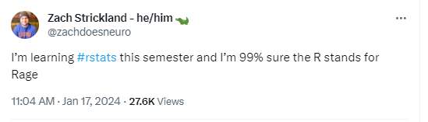
Finally…

Slide 9
Regression

Slide 10
Population Model
We have a set of data that we want to model:
$y$ is the dependent variable (outcome)
$x$ is the independent variable (treatment, demographics, etc.)
Notes:
Y is the thing we want to explain or predict; x is the thing we use to explain. Draw the DAG – note that we are using a simple simple DAG for now with only two bubbles. TO ADD ON NEXT SLIDE: Coefficient is the probability E(Y|X).

Slide 11
Population Model
We have a set of data that we want to model:
$y$ is the dependent variable (outcome)
$x$ is the independent variable (treatment, demographics, etc.)
We don’t believe the relationship is deterministic (why would we care otherwise?) so we assume there is some randomness $ε$
What’s the simplest mathematical relationship between these two variables that could exist?
Notes:
Deterministic relationships aren’t interesting – if I click the clicker and the slide advances every single time with no variation, I don’t need to do any causal inference.

Slide 12
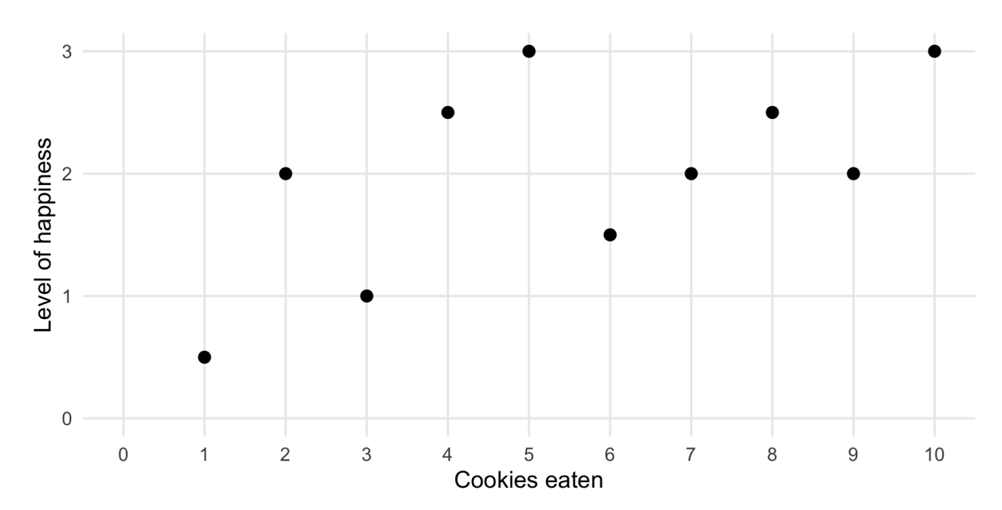
Population Model
Notes:
We have some data: cookies eaten and happiness – what’s the simplest relationship?

Slide 13
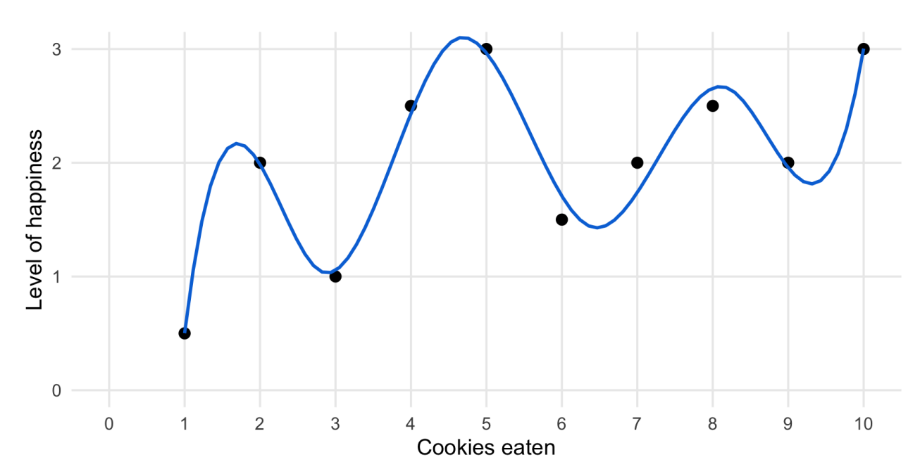
Population Model
Notes:
You could make a very complicated relationship – is this interesting or policy relevant? Why or why not?

Slide 14
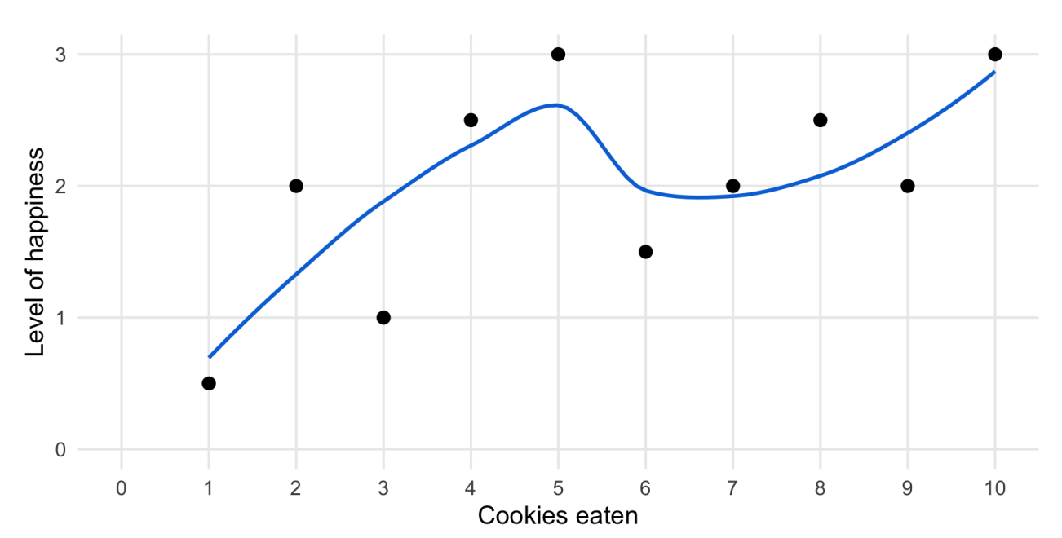
Population Model
Notes:
So instead you smooth it out a little bit

Slide 15
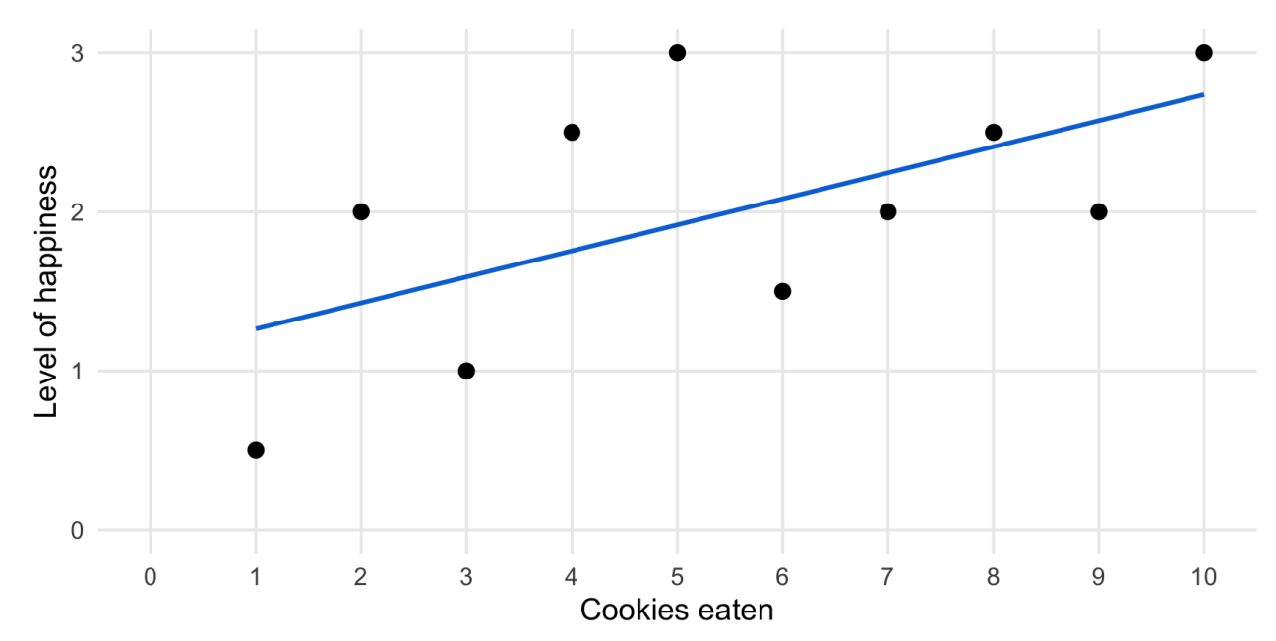
Population Model
Notes:
Smooth until you get to simplest relationship – a line. What’s the practical (earlier, was philosophical) role of epsilon here? Explaining why our data aren’t perfect.

Slide 16
Population Model
$$y=β_{0}+β_{1}x+ε$$
$y$ is the dependent variable (outcome)
$x$ is the independent variable (treatment, demographics, etc.)
$ε$ is a term to allow for random variation in $y$ not captured by $x$
$β$’s are called coefficients, and are the parameters of interest in the model
$β_{0}$: intercept parameter
$β_{1}:$ slope parameter
In our example, our goal is to recover:
$$\hat{happiness}=\hat{β_{0}}+\hat{β_{1}}cookies+ε$$
Notes:
Simplest relationship is linear (the intercept looks like we’re adding complexity, but you’ll see why this is actually simpler – taking all randomness out). Talk about the hat as estimated value and ultimately, predicted values of happiness (depending on question)

Slide 17
Population Model
$$y=β_{0}+β_{1}x+ε$$
Assumptions:
Mean zero error: $𝔼\left[ε\right]=0$. This is without loss of generality, given intercept.
Mean independence: $𝔼\left[ε | x\right]=𝔼\left[ε\right]= 0$ for all values of $x$.
This is often a critical assumption.
What does this mean in terms of our DAG framework?
Consequence: $𝔼\left[y | x\right]=β_{0}+β_{1}x⇒$ causal framework!
Average happiness
Cookies Eaten
Notes:
Draw your own figure herefor next time, doesn’t match the notation and doesn’t look good.

Slide 18
Population Model: Assumptions
$$y=β_{0}+β_{1}x+ε$$
Assumptions:
Mean zero error: $𝔼\left[ε\right]=0$. This is without loss of generality, given intercept.
Notes:
Draw this on the board – can shift line until you get to unconditional mean zero error. More interesting is conditional average error—are there things our model is missing?

Slide 19
Population Model: Assumptions
$$y=β_{0}+β_{1}x+ε$$
Assumptions:
Mean zero error: $𝔼\left[ε\right]=0$. This is without loss of generality, given intercept.
Mean independence: $𝔼\left[ε | x\right]=𝔼\left[ε\right]= 0$ for all values of $x$.
This is often a critical assumption.
What does this mean in terms of our DAG framework?
Notes:
Open backdoor!

Slide 20
Population Model: Assumptions
$$y=β_{0}+β_{1}x+ε$$
Assumptions:
Mean zero error: $𝔼\left[ε\right]=0$. This is without loss of generality, given intercept.
Mean independence: $𝔼\left[ε | x\right]=𝔼\left[ε\right]= 0$ for all values of $x$.
This is often a critical assumption.
What does this mean in terms of our DAG framework?
Consequence: $𝔼\left[y | x\right]=β_{0}+β_{1}x⇒$ causal framework!
Notes:
In our DAG, epsilon should not have a line from or to x – the consequence is that there’s no other randomness left in the pathway between x and y

Slide 21
Population Model: Assumptions
$$y=β_{0}+β_{1}x+ε$$
Assumptions:
Mean zero error: $𝔼\left[ε\right]=0$. This is without loss of generality, given intercept.
Mean independence: $𝔼\left[ε | x\right]=𝔼\left[ε\right]= 0$ for all values of $x$.
This is often a critical assumption.
Additional useful assumptions
Correct specification (similar to DAGs)
Homoskedasticity: $𝕍\left[ε | x\right]=σ^{2}$, a constant
No serial correlation: $Cov\left(ε_{i},ε_{j}|x\right)=0$
Distributional assumptions (Even less common/necessary): $ε_{i}|x∼N(0,σ^{2})$
Notes:
We’ll go through these in more detail later. First two are enough to pin down the coefficients and say something about bias/consistency.

Slide 22
Estimating a Regression: Intuition
$$y=β_{0}+β_{1}x+ε$$
Our two main assumptions give a system of equations used to solve for $\hat{β}$:
Mean zero error: $𝔼\left[y−β_{0}−β_{1}x\right]=0$
Mean independence: $𝔼\left[ε | x\right]=x\left(y−β_{0}−β_{1}x\right)=0$
You can solve this system for the desired values of $β_{0},β_{1}$
See SC for a mathematical derivation
Notes:
This is where you would use linear properties of expectations, etc.

Slide 23
Estimating a Regression: Intuition
$$y=β_{0}+β_{1}x+ε$$
Our two assumptions give us a system of equations used to solve for $\vec{β}:$
Mean zero error: $𝔼\left[y−β_{0}−β_{1}x\right]=0$
Mean independence: $𝔼\left[ε | x\right]=x\left(y−β_{0}−β_{1}x\right)=0$
Intuitively, what is happening here?
Let’s play a regression game:
https://sophieehill.shinyapps.io/eyeball-regression/

Slide 24
Ordinary Least Squares (OLS)
$$y=β_{0}+β_{1}x+ε$$
Definition: The sum of squared errors (SSE):
$$SSE=\sum_{i=1}^{N}{{\hat{ε_{i}}}^{2}}= \sum_{i=1}^{N}{{\left(y_{i} −\hat{y_{i}}\right)}^{2}}$$
Implicit cost function for errors in estimation
OLS returns $β_{0}, β_{1}$ that minimize this value given all observed data!
Sidenote: $\hat{ε}$ is called a residual (importantly different from an error term)
The predicted regression equation is then given by:
$$\hat{y}=\hat{β_{0}}+\hat{β_{1}}x$$
Notes:
Residual and error term are different – you don’t pin down or estimate the value of real randomness; you take it as given in the data and create the residual to be minimized. Go to R just for the model and the summary, then come back for next slide to talk about interpretation

Slide 25
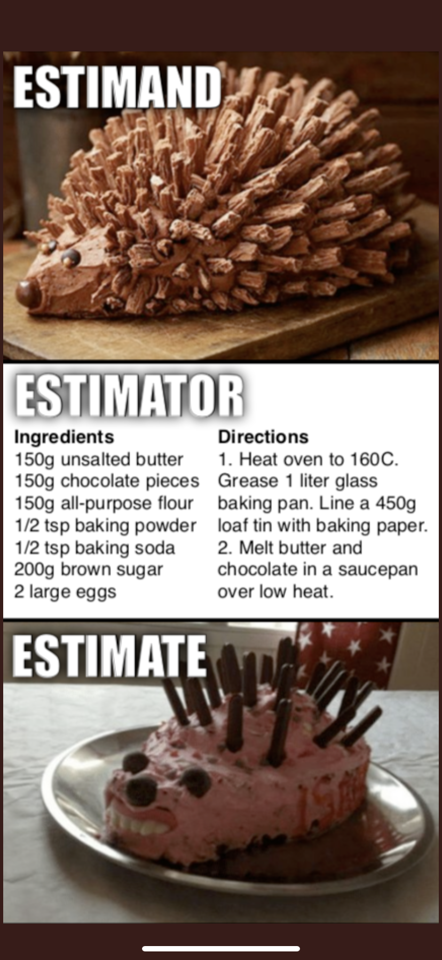
Sidenote on Estimation
Notes:
Move this slide around somewhere?

Slide 26
Interpreting the Results
$$\hat{y}=\hat{β_{0}}+\hat{β_{1}}x$$
In the code example, $\hat{β_{0}}=−.07$ and $\hat{β_{1}}=$5.7.
What do these mean?
Can use the values for prediction, given:
Any value of $x$ or change $Δx$
Question: what do we think $\hat{y}(\overline{x})$ would be?
Where is prediction useful?
Lots of observed data $⇒$ lots of predictive power
Never predict outside the sample
Notes:
Why shouldn’t we predict outside the sample? Look at our figure here and talk about extrapolation

Slide 27
Goodness of Fit
$$\hat{y}=\hat{β_{0}}+\hat{β_{1}}x$$
There are two separate things we care about when we run a regression:
Is the model fitting the data?
Is the model capturing a causal parameter we care about?
To check on 1, we use goodness of fit measures:
SST (Sum of Squares Total)
$$SST=\sum_{\left\{i=1\right\}}^{n}{{\left(y_{i}−\overline{y}\right)}^{2}}$$
Notes:
1 and 2 are very commonly conflated but they are not the same. SST is the total variation in outcome variable

Slide 28
Goodness of Fit
$$\hat{y}=\hat{β_{0}}+\hat{β_{1}}x$$
There are two separate things we care about when we run a regression:
Is the model fitting the data?
Is the model capturing a causal parameter we care about?
To check on 1, we use goodness of fit measures:
SSE (Sum of Squares Explained)
$$SSE=\sum_{\left\{i=1\right\}}^{n}{{\left({\hat{y}}_{i}−\overline{y}\right)}^{2}}$$
Notes:
SSE is the fraction of the variation in y we capture in the regression

Slide 29
Goodness of Fit
$$\hat{y}=\hat{β_{0}}+\hat{β_{1}}x$$
There are two separate things we care about when we run a regression:
Is the model fitting the data?
Is the model capturing a causal parameter we care about?
To check on 1, we use goodness of fit measures:
SSR (Sum of Squared Residuals)
$$SSR=\sum_{\left\{i=1\right\}}^{n}{{{\hat{u}}_{i}}^{2}}$$
Notes:
SSR is what’s left over

Slide 30
Goodness of Fit
$$\hat{y}=\hat{β_{0}}+\hat{β_{1}}x$$
There are two separate things we care about when we run a regression:
Is the model fitting the data?
Is the model capturing a causal parameter we care about?
To check on 1, we use goodness of fit measures:
Then, we define the fraction of SST explained by our regression:
$$R^{2}=\frac{SSE}{SST}=1−\frac{SSR}{SST}$$

Slide 31
Goodness of Fit
$$\hat{y}=\hat{β_{0}}+\hat{β_{1}}x$$
There are two separate things we care about when we run a regression:
Is the model fitting the data?
Is the model capturing a causal parameter we care about?
Some notes on $R^{2}$:
Always ranges between 0 and 1 (0 = no relationship; 1 = perfect line)
Related to the correlation between $\hat{y}$ and $y$ – hence, not indicative of causality!
Even low $R^{2}$ models can have strong causal interpretations – be clear on what your research goal is!
Notes:
R2 is measuring something different than the strength of the causal relationship, it’s measuring predictive power or how much variation you are utilizing. These aren’t the same.

Slide 32
Goal: Why are we regging?

Slide 33
Unbiasedness: Estimating Causal POI
$$\hat{y}=\hat{β_{0}}+\hat{β_{1}}x$$
Suppose that we have a correctly identified model, such that $β_{1}$ is a true causal parameter of interest (POI)
How do we know the regression gives us $β_{1}?$
Different sets of data will generate different $\hat{β_{1}}$
We want our regression to give us $β_{1}$ on average
In math, what do we need to assume in order for $𝔼\left[\hat{β_{1}} \right]=β_{1}$?
Notes:
We could do a MC simulation like we did last time to show this is true under certain assumptions. Try coding it up if you are curious!

Slide 34
Unbiasedness: Estimating Causal POI
$$\hat{y}=\hat{β_{0}}+\hat{β_{1}}x$$
Suppose that we have a correctly identified model, such that $β_{1}$ is a true causal parameter of interest (POI)
How do we know $𝔼\left[\hat{β_{1}} \right]=β_{1}?$
Data Assumptions:
Correct Specification. Model is correctly specified as $\hat{y}=\hat{β_{0}}+\hat{β_{1}}x$
Random Sampling. Random sampling of data
Sample Variation. Sample variation in $x_{i}$
Notes:
Are these assumptions testable?

Slide 35
Unbiasedness: Estimating Causal POI
$$\hat{y}=\hat{β_{0}}+\hat{β_{1}}x$$
Suppose that we have a correctly identified model, such that $β_{1}$ is a true causal parameter of interest (POI)
How do we know $𝔼\left[\hat{β_{1}} \right]=β_{1}?$
Data Assumptions:
Correct Specification. Model is correctly specified as $\hat{y}=\hat{β_{0}}+\hat{β_{1}}x$
Random Sampling. Random sampling of data
Sample Variation. Sample variation in $x_{i}$
Key Assumption: Mean Independence. $𝔼\left[ε | x\right]=𝔼\left[ε\right]=0$
Notes:
Are these assumptions testable?

Slide 36
Unbiasedness: Estimating Causal POI
$$\hat{y}=\hat{β_{0}}+\hat{β_{1}}x$$
Suppose that we have a correctly identified model, such that $β_{1}$ is a true causal parameter of interest (POI)
How do we know $𝔼\left[\hat{β_{1}} \right]=β_{1}?$
Data Assumptions:
Correct Specification. Model is correctly specified as $\hat{y}=\hat{β_{0}}+\hat{β_{1}}x$
Random Sampling. Random sampling of data
Sample Variation. Sample variation in $x_{i}$
4. Key Assumption: Mean Independence. $𝔼\left[ε | x\right]=𝔼\left[ε\right]=0$
Then we can say that our regression parameters are unbiased
Can we see this in toy data (Monte Carlo simulation)?
Notes:
Are these assumptions testable?

Slide 37
This Time
Sampling Distributions
Standard Errors and Confidence Intervals
Bootstrapping
Next Time
p values
Hypothesis testing

Slide 38
Multivariate Regression

Slide 39
Population Model: Multiple Variables
$$y=β_{0}+β_{1}D+β_{2}x_{2}+ …+β_{n}x_{n}+ε$$
$y$ is the dependent variable (outcome)
Each $x_{i}$ (and $D)$ is a different independent variable:
Treatment status
Demographics (race, income, education, location, etc.)
Why would we want to include multiple variables in a regression?
Notes:
This is not a trick question – think back to our frameworks!

Slide 40
Population Model: Multiple Variables
$$y=β_{0}+β_{1}D+β_{2}x_{2}+ …+β_{n}x_{n}+ε$$
$y$ is the dependent variable (outcome)
Each $x_{i}$ (and $D)$ is a different independent variable:
Treatment status
Demographics (race, income, education, location, etc.)
Why would we want to include multiple variables in a regression?
Y: Hospitalization Rate
D: Health Behaviors
X: Education
Affects both $D$ and $Y$!
$$D$$
$$Y$$
$$X$$

Slide 41
Controlling for Variables
$$y=β_{0}+β_{1}D+β_{2}X+ε$$
We are curious about the effect of $D$ on $Y$
We know that $D→Y$, but there’s another open channel: $D←X→Y$
To close this channel, we want to “control for” education
Visualizing this with a DAG
Notes:
I recommend looking at this site in more detail – we’ll cover the high points here. Videos from Andrew can be opened full screen, talk through when we control for things in a DAG.

Slide 42
Controlling for Variables
$$y=β_{0}+β_{1}D+β_{2}X+ε$$
We are curious about the effect of $D$ on $Y$
We know that $D→Y$, but there’s another open channel: $D←X→Y$
To close this channel, we want to “control for” education
Visualizing this with a DAG
Controlling “partials out” conditional means $𝔼\left[Y | X\right], 𝔼[D|X]$
Frisch-Waugh-Lovell (FWL) Theorem
Illustration: https://tinyurl.com/mrx32397
Notes:
I recommend looking at this site in more detail – we’ll cover the high points here. Videos from Andrew can be opened full screen, talk through when we control for things in a DAG.

Slide 43
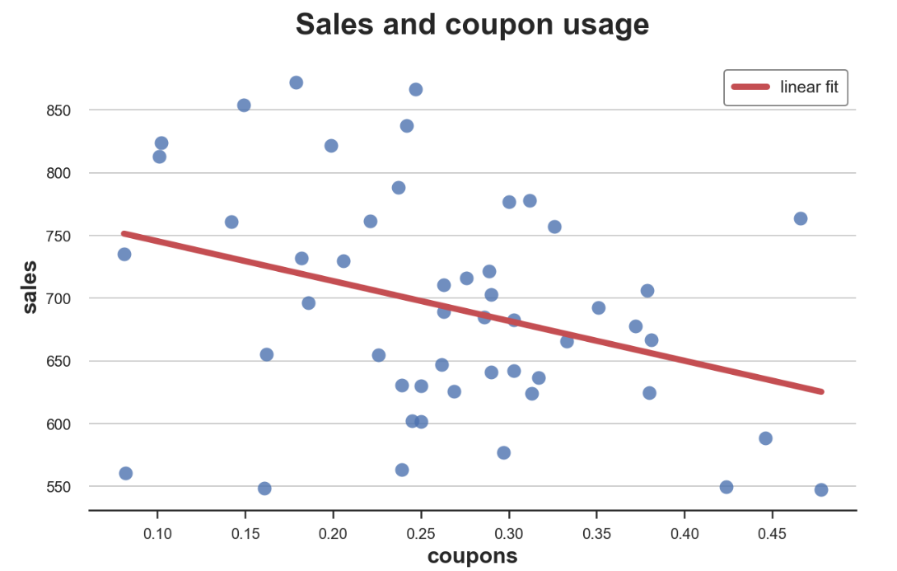
Controlling for Variables
Hospitalizations and Health Behavior (A1C check)
$$y=β_{0}+β_{1}D+β_{2}X+ε$$
Total Annual Diabetes Hospitalizations,
Regional Level
Rate of A1C checks per 1,000 diabetics
Notes:
Note – I’ve “health-ized” the example in the website here. Data here is a local physician’s practice, or health market. What does the line mean? What confounders might we be interested in here?

Slide 44
Controlling for Variables
Hospitalizations and Health Behavior (A1C check)
$$y=β_{0}+β_{1}D+β_{2}X+ε$$
But what about education? What drives health behaviors?
Total Annual Diabetes Hospitalizations,
Regional Level
Rate of A1C checks per 1,000 diabetics

Slide 45
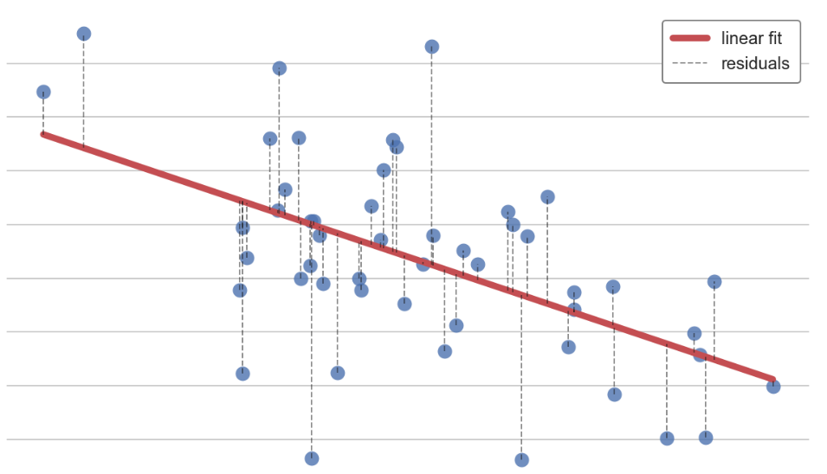
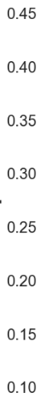
Controlling for Variables: A1Cs and Education
Health Behavior (A1C check) and Education
$$y=β_{0}+β_{1}D+β_{2}X+ε$$
Rate of A1C Checks per 1,000 Diabetics
Average Education in Region
Notes:
Note – there’s a strong relationship here! What does that mean for our initial assessment? We have violated the assumption that E(eps|x)=0 given that we relegated education to epsilon

Slide 46
Controlling for Variables: A1Cs and Education
Health Behavior (A1C check) and Education
$$y=β_{0}+β_{1}D+β_{2}X+ε$$
Rate of A1C Checks per 1,000 Diabetics
Controlling for education removes this linear trend, leaving only the residuals
Average Education in Region
Notes:
We move education out of the error term and correct for this correlation

Slide 47
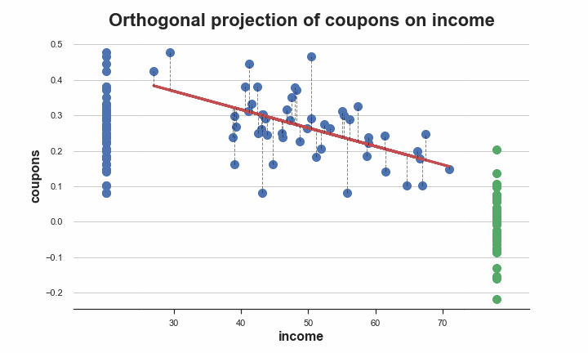
Partialling out Education
Notes:
Ignore the axes here.

Slide 48
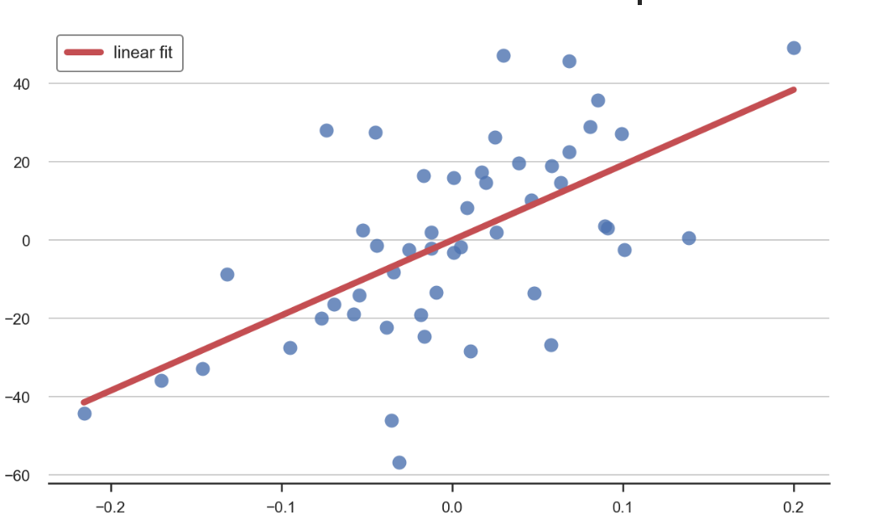
FWL: Residual $Ys$ on Residual $Ds$
Hence, FWL eliminates $𝔼\left[D | X\right]$ and $𝔼[Y|X$] in order to isolate $𝔼[Y|D]$ when $X$ is known:
Obtain $𝔼\left[Y | X\right]$
Subtract (1) out from $Y$in order to get residuals $Y^{R}$
Obtain $𝔼[D|X]$
Subtract (3) out from $D$ in order to get residuals $D^{R}$
Describe the relationship between $Y^{R}$ and $D^{R}$
Hospitalizations and Health Behavior (A1C check)
Residual Hospitalizations
Residual Rate of A1C checks
Notes:
Let’s see how this works in R

Slide 49
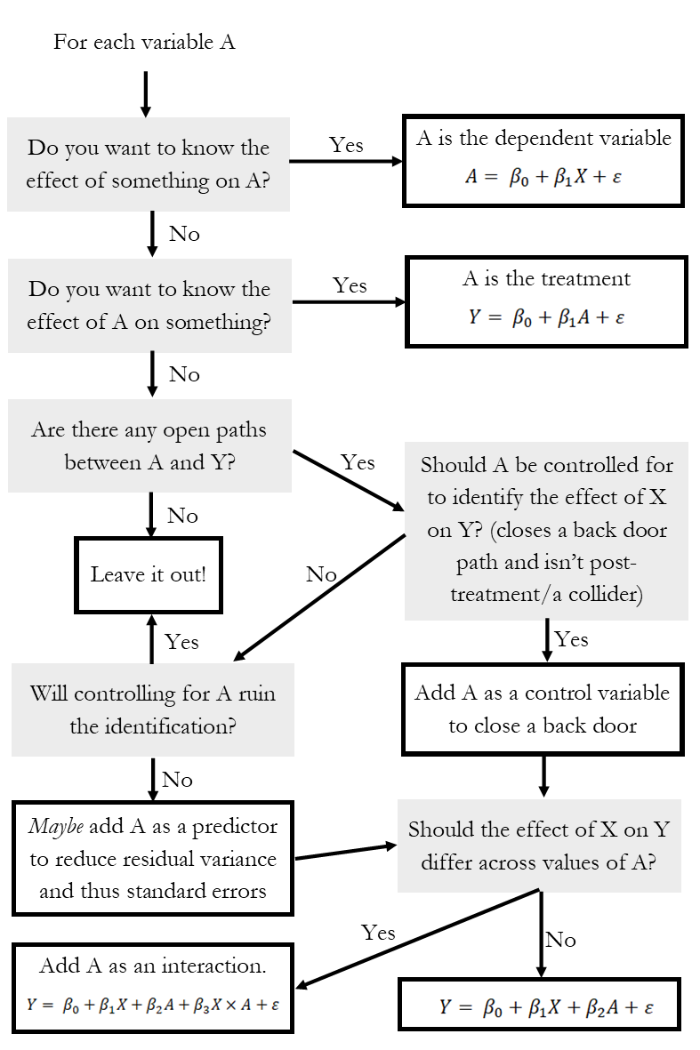
So what do I control for?
We add regressors to close all back doors and focus on a causal parameter of interest$(β_{1})$
If there is correlation between $Y$ and $x_{2}$ and $x_{1}$ and $x_{2}$, you should control for it
Need to have data on $x_{2}$ (obviously)
Notes:
Talk through this – what is a collider/post-treatment (something like controlling for occupation to assess gender wage gap). Think about Andrew’s videos!

Slide 50
Inference on Regression Coefficients

Slide 51
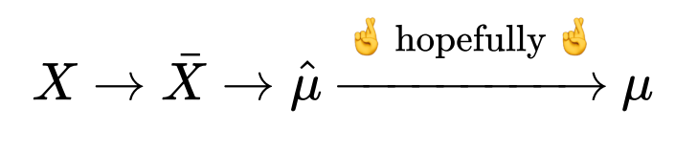
Inference: How well does our data answer our question?
$$y=β_{0}+β_{1}x_{1}+β_{2}x_{2}+ …+β_{n}x_{n}+ε$$
Any regression is left with residual variation, $ε$
Additionally, sampling variation means that if we change the data (a little), we change $\hat{β_{1}}$ (potentially a lot)
A key question of a regression model is therefore:
How certain am I that my $\hat{β_{1}}$ is telling me something informative about $β?$
Notes:
Hopefully, the law of large numbers kicks in – how do we know it does? Think back to our MC simulation from last time.

Slide 52
Inference: How well does our data answer our question?
$$y=β_{0}+β_{1}x_{1}+β_{2}x_{2}+ …+β_{n}x_{n}+ε$$
Any regression is left with residual variation, $ε$
Additionally, sampling variation means that if we change the data (a little), we change $\hat{β_{1}}$ (potentially a lot)
A key question of a regression model is therefore:
How certain am I that my $\hat{β_{1}}$ is telling me something informative about $β?$
This is the question of inference
To get there, use one of our useful assumptions (homoskedasticity):
$$𝕍\left[ε | X\right]=σ^{2}$$
Notes:
Next time, we’ll talk about what occurs if homoskedasticity is violated. This is illustrative of the simple case, but not prohibitive.

Slide 53
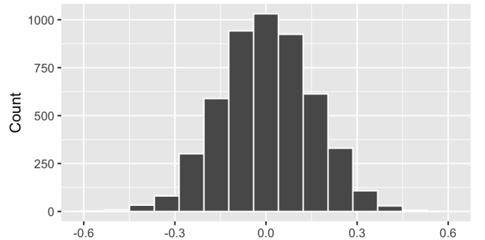
A Simulation Example
The intuition for inference (and standard errors, p-values, etc.) is based on simulations of a null world
Randomly shuffle the A1C checks and hospitalizations columns $↑$5,000 times, compare results for estimated $\hat{β_{1}}$
$$\hat{β_{1}}$$
Notes:
What is a null world like in our example? A1Cs don’t affect hospitalizations at all. Each simulation is a random draw of data in a null world – no effect exists.

Slide 54
A Simulation Example
The intuition for inference (and standard errors, p-values, etc.) is based on simulations of a null world
Randomly shuffle the A1C checks and hospitalizations columns $↑$5,000 times, compare results
What if this is the $\hat{β_{1}}$ our real data told us?
Notes:
If this is our estimated slope (after controlling) – this is unlikely given a bunch of random null worlds (the exact level of unlikeliness is the p-value)

Slide 55
Sampling Distribution of $\hat{β_{i}}$
$$y=β_{0}+β_{1}x_{1}+β_{2}x_{2}+ …+β_{n}x_{n}+ε$$
Under homoskedasticity, there is a nice sampling distribution for any coefficient
$$\hat{β_{i}}∼𝒩 \left(β,\frac{σ^{2}}{\sum_{\left\{i=1\right\}}^{n}{{\left(x_{i}−\overline{x}\right)}^{2}}}\right)=𝒩\left(β,\frac{σ^{2}}{SST_{x}}\right)$$
Notes:
Language here – normally distributed with a mean and variance. Note that variance diminishes with N, and that true sigma^2 is a population parameter that is unknown to us (just like true beta)

Slide 56
Sampling Distribution of $\hat{β_{i}}$
$$y=β_{0}+β_{1}x_{1}+β_{2}x_{2}+ …+β_{n}x_{n}+ε$$
Under homoskedasticity, there is a nice sampling distribution for any coefficient
$$\hat{β_{i}}∼𝒩 \left(β,\frac{σ^{2}}{\sum_{\left\{i=1\right\}}^{n}{{\left(x_{i}−\overline{x}\right)}^{2}}}\right)=𝒩\left(β,\frac{σ^{2}}{SST_{x}}\right)$$
Unbiasedness
Notes:
As our data grows, our estimate is centered around the truth – the more data, the more precise that estimate is.

Slide 57
Sampling Distribution of $\hat{β_{i}}$
$$y=β_{0}+β_{1}x_{1}+β_{2}x_{2}+ …+β_{n}x_{n}+ε$$
Under homoskedasticity, there is a nice sampling distribution for any coefficient
$$\hat{β_{i}}∼𝒩 \left(β,\frac{σ^{2}}{\sum_{\left\{i=1\right\}}^{n}{{\left(x_{i}−\overline{x}\right)}^{2}}}\right)=𝒩\left(β,\frac{σ^{2}}{SST_{x}}\right)$$
We typically estimate this variance from the regression:
$$s^{2}=\frac{\sum_{\left\{i=1\right\}}^{n}{{\hat{e}}_{i}^{2}}}{n−k−1}=\frac{SSE}{n−k−1}$$
Given our estimate of $σ^{2}$, we calculate standard errors for coefficients from the variance-covariance matrix: $s^{2}{\left(X^{′}X\right)}^{\left\{−1\right\}}$
Consistency
Notes:
As our data grows, our estimate is centered around the truth – the more data, the more precise that estimate is. We won’t go over the VCE because we don’t want to get bogged down in linear algebra, but the matrix contains estimated variance and covariance parameters for each coefficient; standard error is the square root of the diagonal.

Slide 58
Sampling Distribution of $\hat{β_{i}}$
$$y=β_{0}+β_{1}x_{1}+β_{2}x_{2}+ …+β_{n}x_{n}+ε$$
Under homoskedasticity, there is a nice sampling distribution for any coefficient
$$\hat{β_{j}}∼𝒩 \left(β,\frac{σ^{2}}{\sum_{\left\{i=1\right\}}^{n}{{\left({x_{j},}_{i}−{\overline{x}}_{j}\right)}^{2}}}\right)=𝒩\left(β,\frac{σ^{2}}{SST_{x_{j}}}\right)$$
Hence, what affects the precision of our regression coefficient?
The error variance ($↑σ^{2}⇒↑σ_{β})$
Variation in $x_{j}$ ($↑SST_{x_{j}}⇒↓σ_{β})$ – variation in $x_{j}$ is a good thing!
Size of data: since SST is summed over $n$, $Var(\hat{β_{j}})$ shrinks at $\frac{1}{n}$
Notes:
1. Is unknown

Slide 59
Standard Errors
$$y=β_{0}+β_{1}D+β_{2}X+ε$$
The standard deviation of an estimator is referred to as a standard error
Standard errors allow you to use what you observe in a regression to test hypotheses about the (unobserved) data generating process

Slide 60
Hypothesis Testing
$$y=β_{0}+β_{1}D+β_{2}X+ε$$
Example: We care about the effect of $D$ on $Y$ after controlling for $X$.
Can we say that $β_{1}≠0$?

Slide 61
Hypothesis Testing
$$y=β_{0}+β_{1}D+β_{2}X+ε$$
Example: We care about the effect of $D$ on $Y$ after controlling for $X$.
Can we say that $β_{1}≠0$?
Null hypothesis: $ℋ_{0}:β_{1}=0$ (the typical null hypothesis)
Alternative hypothesis: $ℋ_{A}:β_{1}≠0$
Rejection value: $α$ (typically 0.05)
Notes:
The null hypothesis is our simulated world.

Slide 62
Statistical Tests on Coefficients
$$y=β_{0}+β_{1}D+β_{2}X+ε$$
Statistical tests tell you something about if a supposed distribution for a parameter is unlikely
Related calculations:
p-value: the exact percentile of our statistic
T-statistic: standardized way of representing the percentile (standard normal)
$$t_{i}=\frac{\hat{β_{i}}}{se(\hat{β_{i}})}$$
How are these related to $α?$

Slide 63
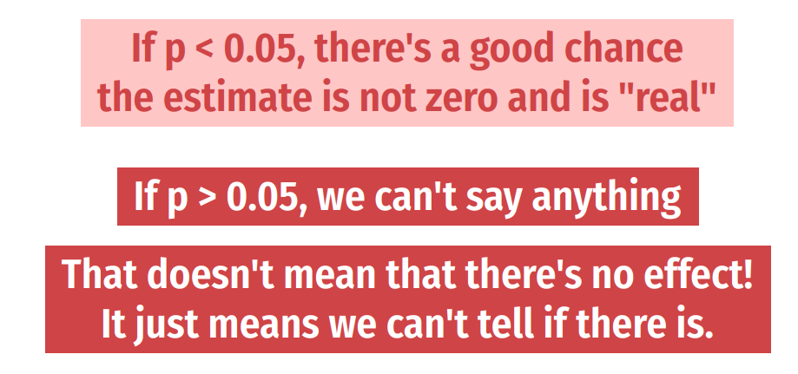
Statistical Significance
Notes:
We’ll talk more about this in a minute after regression tables.

Slide 64
Types of Control Variables
Notes:
Break here?

Slide 65

Types of Control Variables: Sliders and Switches
Notes:
Continuous and discrete – we’ll talk about different interpretation of effects here, and more next time. Examples of discrete variables: Racial, ethnic, gender group identification
Years of education, marriage, etc.

Slide 66
How does interpretation change?
For a multivariate regression:
$$y=β_{0}+β_{1}x_{1}+β_{2}x_{2}+ …+β_{n}x_{n}+ε,$$
$β_{i}$ is now the average change in $y$ when $x_{i}$ increases by 1 holding everything else constant
When $x_{i}$ is continuous, does a one-unit change in $x$ make sense?
When $x_{i}$ is discrete, effect of “turning on” the switch
Notes:
Interpretation now relies on holding everything else in the regression constant – if this doesn’t work for what you want to know, need to rethink the design of the regression (e.g., interactions). Also think about causality in the context of FWL – we aren’t identifying causal pathways, we’re closing back doors! (This is model-based inference at its best, the whole regression focuses on one pathway in the DAG that you want).

Slide 67
How does interpretation change?
For a multivariate regression:
$$y=β_{0}+β_{1}x_{1}+β_{2}x_{2}+ …+β_{n}x_{n}+ε,$$
$β_{i}$ is now the average change in $y$ when $x_{i}$ increases by 1 holding everything else constant
When $x_{i}$ is continuous, does a one-unit change in $x$ make sense?
When $x_{i}$ is discrete, effect of “turning on” the switch
Discrete variables in regressions are called dummy variables
$$x_{i}=\left\{\begin{aligned}1 \\ 0\end{aligned} \right.\begin{matrix}if urban \\ if not urban\end{matrix}$$
Notes:
We’ll talk about interpretation of dummy variables here, not in lecture 4

Slide 68
Discrete Regressors
Suppose we are modeling the demand for health services:
$$y_{i}=β_{0}+β_{1}x_{i1}+β_{2}x_{i2}+αU_{i}+ε_{i},$$
where $U_{i}$ indicates residing in an urban region
How do we interpret $α$ (if it’s a coefficient of interest)?
Notes:
Talk about subscripts here

Slide 69
Discrete Regressors
Suppose we are modeling the demand for health services:
$$y_{i}=β_{0}+β_{1}x_{i1}+β_{2}x_{i2}+αU_{i}+ε_{i},$$
where $U_{i}$ indicates residing in an urban region
How do we interpret $α$?
Two groups: one where $αU_{i}=α$ and one where $αU_{i}=0$
Hence, dummy variables capture a shift in the intercept of a regression
Notes:
Talk about subscripts here

Slide 70
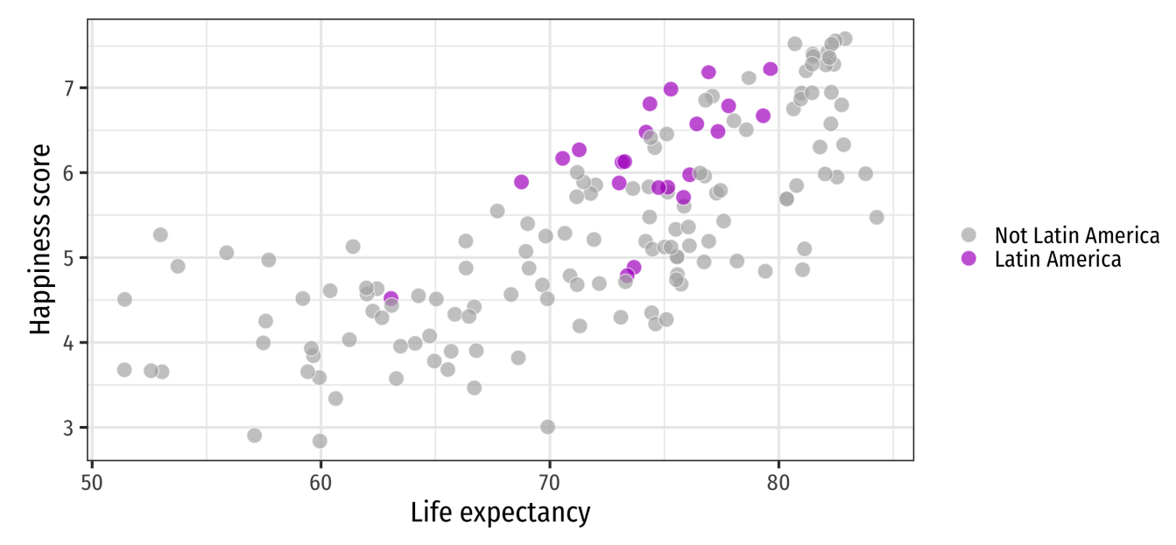
Discrete Regressors

Slide 71
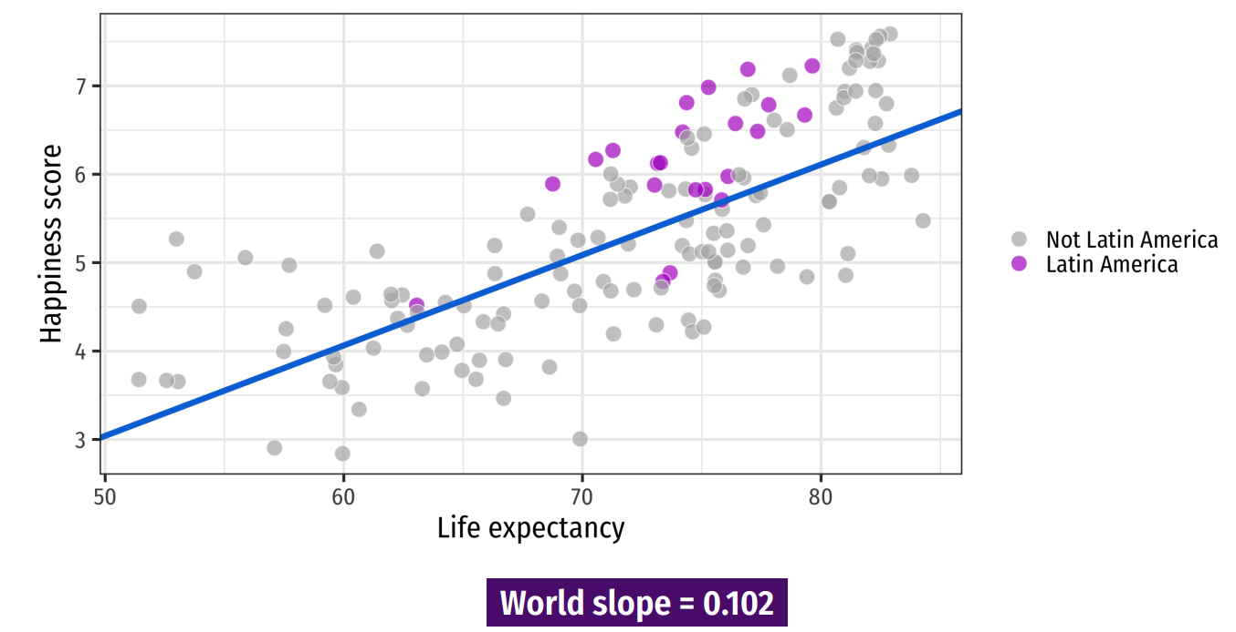
Discrete Regressors
Notes:
Here’s the world slope – does it seem to go through the points for Latin America? No! If we were to run a separate regression just on those points we’d get a different intercept.

Slide 72
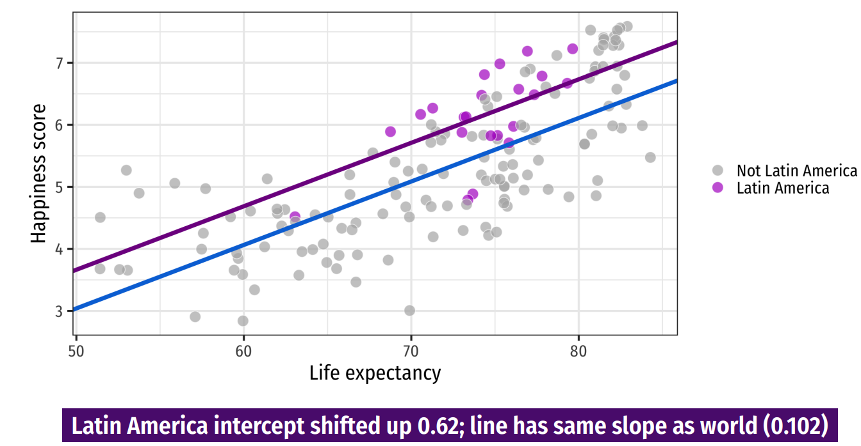
Discrete Regressors
Notes:
So add a dummy intercept! What’s the interpretation? Next time – talk about if we want the slope to vary across groups

Slide 73
The Dummy Variable Trap
Suppose we define a new variable
$R_{i}=\left\{\begin{aligned}1 if rural \\ 0 if urban \end{aligned}\right.$
and include both $R_{i}$ and $U_{i}$ in a regression model.
What would happen?
Notes:
Perfect Multicolinearity = multiple solutions (if true coefficient is +5 for urban, then could be +7, -2, or -10-,-15, etc.)

Slide 74
The Dummy Variable Trap
Suppose we define a new variable
$R_{i}=\left\{\begin{aligned}1 if rural \\ 0 if urban \end{aligned}\right.$
and include both $R_{i}$ and $U_{i}$ in a regression model.
What would happen?
Now, two explanatory variables are perfectly colinear, since
$$R_{i}=1−U_{i}$$
This model cannot be estimated
Notes:
Perfect Multicolinearity = multiple solutions (if true coefficient is +5 for urban, then could be +7, -2, or -10-,-15, etc.)

Slide 75
Avoiding the Dummy Variable Trap
Suppose we have four regions that we care about
(South, Midwest, East, West)
We can include three ($N−1)$ dummy variables in regression:
Need to pick a baseline category
Interpreted as the “comparison group”
$$WAGE=β_{1}+δ_{1}SOUTH+δ_{2}MIDWEST+δ_{3}WEST+β_{2}EDUC+ε$$
Notes:
Talk about subscripts here

Slide 76
Avoiding the Dummy Variable Trap
Suppose we have four regions that we care about
(South, Midwest, East, West)
We can include three ($N−1)$ dummy variables in regression:
Need to pick a baseline category
Interpreted as the “comparison group”
$$WAGE=β_{1}+δ_{1}SOUTH+δ_{2}MIDWEST+δ_{3}WEST+β_{2}EDUC+ε$$
$$E\left(WAGE\right)=\left\{\begin{aligned}\left(β_{1}+δ_{3}\right)+β_{2}EDUC for West \\ \left(β_{1}+δ_{2}\right)+β_{2}EDUC for Midwest \\ \left(β_{1}+δ_{1}\right)+β_{2}EDUC for South \\ β_{1}+β_{2}EDUC for East\end{aligned}\right.$$
Notes:
Interpretation – start from bottom with “reference category”

Slide 77
Avoiding the Dummy Variable Trap
Suppose we have four regions that we care about
(South, Midwest, East, West)
We can include three ($N−1)$ dummy variables in regression:
Need to pick a baseline category
Interpreted as the “comparison group”
Interpretation is difficult, so typically need a joint test to assess value of categorical relationships
Notes:
We’re about to talk about significance in next section, so we can return to this.

Slide 78
Practical Regression Tips
Notes:
As we move into each method, I’ll try to give a “like the pros” section that talks about practical tips (coding, data structure, what goes in the paper, etc.)

Slide 79
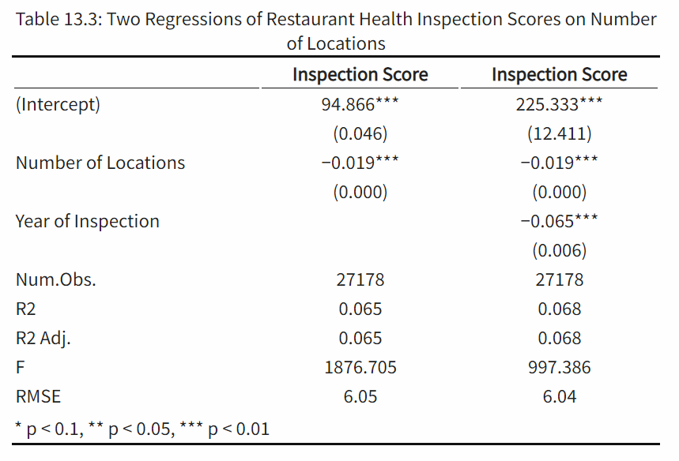
Reading & Constructing a Regression Table
Concise way to present multiple regressions
What should you look for when reading a table?
Key differences across models
Identify parameter authors care about
Look for changes across columns

Slide 80
Reading & Constructing a Regression Table
Concise way to present multiple regressions
What should you look for when reading a table?
Key differences across models
Identify parameter authors care about
Look for changes across columns
Other notes:
Asterisks and standard errors
Notes:
Think carefully about what type of standard errors you have. Tables should be self-contained, so that there are notes explaining what each model is, the types of Ses, etc.

Slide 81
Reading & Constructing a Regression Table
Concise way to present multiple regressions
What should you look for when reading a table?
Key differences across models
Identify parameter authors care about
Look for changes across columns
Other notes:
Asterisks and standard errors
N

Slide 82
Reading & Constructing a Regression Table
Concise way to present multiple regressions
What should you look for when reading a table?
Key differences across models
Identify parameter authors care about
Look for changes across columns
Other notes:
Asterisks and standard errors
N
Overall model performance

Slide 83
Reading & Constructing a Regression Table
Interpreting Results
Think “A 1-unit change in x…”
Economic vs. statistical significance
Causality or association?
Notes:
Note: generally don’t interpret incidental coefficients on control variables – these don’t have a causal interpretation in your approach! You wrote a regression to identify a certain causal pathway, so the parameter you get on a backdoor path isn’t the causal effect of that path (see Hunermund and Louw in Github repo).

Slide 84
Reading & Constructing a Regression Table
Interpreting Results
Think “A 1-unit change in x…”
Economic vs. statistical significance
Causality or association?
How do you make the table?

Slide 85
Types of Significance
What does significance mean?
Something that isn’t significant isn’t wrong – just insignificant
Precise nulls are of research interest
A model should never be modified ex-post to obtain significant results!
One test is rarely sufficient to come to a conclusion
This is why economics papers are typically 50+ pages plus appendix
Notes:
New thing to hit here: economic versus statistical significance – a p-value is all well and good, but what is the takeaway? What’s the story?

Slide 86
Types of Significance
What does significance mean?
Something that isn’t significant isn’t wrong – just insignificant
Precise nulls are of research interest
A model should never be modified ex-post to obtain significant results!
One test is rarely sufficient to come to a conclusion
This is why economics papers are typically 50+ pages plus appendix
Difference between statistical significance and economic significance
What does your result mean?
What does it mean to be statistically significant in this context?
What does the estimated coefficient imply about policy? Welfare? Etc.?
Notes:
New thing to hit here: economic versus statistical significance – a p-value is all well and good, but what is the takeaway? What’s the story?

Slide 87
What do my results mean?
Types of causal validity
Notes:
We’re gonna talk about some types of “causal validity” – not R-squared but when the link between regression and model is strong enough.

Slide 88

What do my results mean?
Types of causal validity
Construct validity: are we measuring what we want to measure?
How is the outcome variable measured?
Are we capturing the right spot in the distribution (mean, median, etc.?)
Notes:
This is also known as the street light effect – researchers shine the light just on the street, miss what’s to the side. Are you asking the right questions? An example: a program hopes to improve commitment to school, and boasts that it improves test scores -- does that measure the outcome you want (teacher performance, kid happiness, etc.?) or does it just measure how good kids are at taking tests. Data limitations play a big role here (in health, think quality measurements, or metrics of risk/equity/etc.)

Slide 89
What do my results mean?
Types of causal validity
Construct validity: are we measuring what we want to measure?
Notes:
There are example papers of these in the github repo

Slide 90
What do my results mean?
Types of causal validity
Construct validity: are we measuring what we want to measure?
Statistical validity: are your statistics correct?
Do you have enough statistical power to get the results that you want?
Are all of your required assumptions met?
Was there any p-hacking involved in getting the answer you published?
Are your associations causal or spurious correlation?
Notes:
These are questions that are nearly impossible to answer in a paper or project (okay, you can do a power calculation – ish). But you still need to think carefully about each of these.

Slide 91
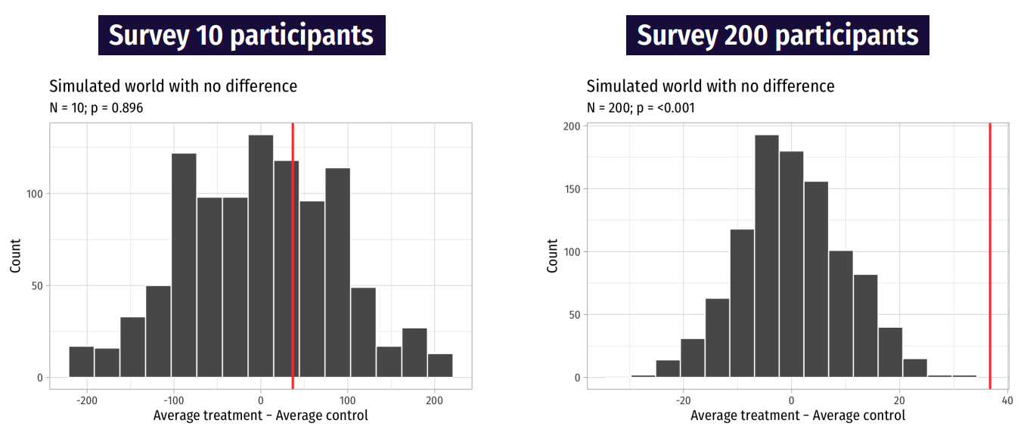
Statistical Power
Notes:
If you sample a small group repeatedly, you get a lot of different answers. But if you sample a large group even fewer times, your effects are more noticeable. Power calculations can tell you something about what the sample size should be (going out the window with big data)

Slide 92
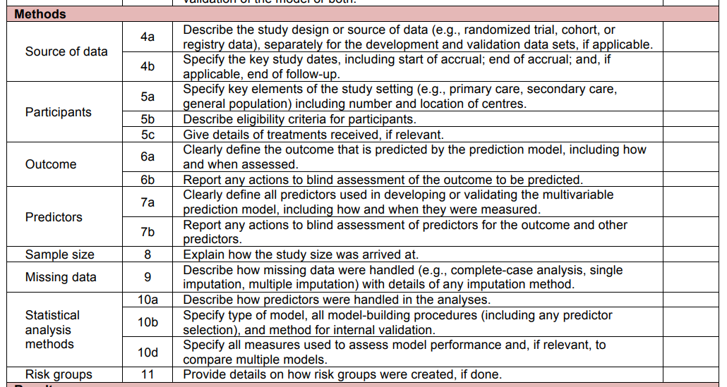
How do I report my results and assumptions?
The TRIPOD Checklist has useful structure on what you should be watching out for
Notes:
Also includes things like – what limitations should be noted, what should go in a discussion, etc. We’ll try to talk more about this with each method we cover.

Slide 93
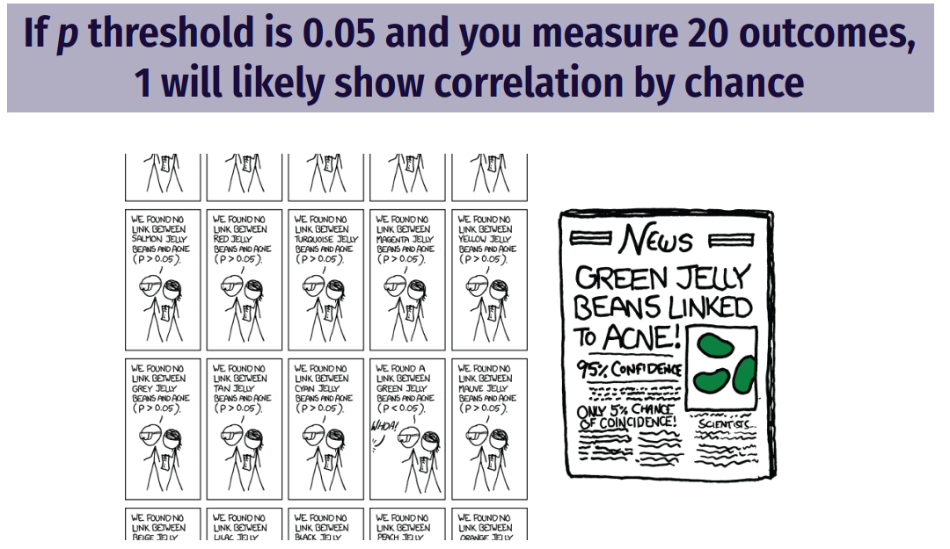
Are my results hacked? Are they spurious?
Notes:
For p-hacking, remember the website: https://projects.fivethirtyeight.com/p-hacking/. Did you correct for multiple testing? Did you perform 20 tests and report the one significant result?

Slide 94
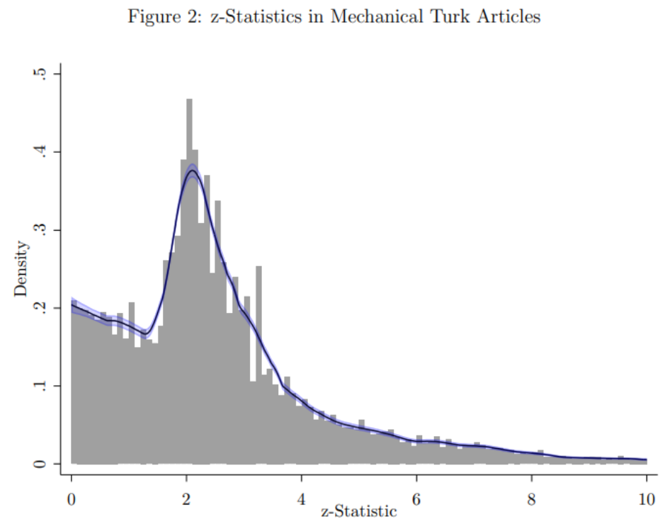
Aggregate p-hacking: Publication Bias
Notes:
Distribution of p-values in research – what does this tell you? (Note that the z-stat is the test statistic, the inverse of the p-value)

Slide 95
What do my results mean?
Types of causal validity
Construct validity: are we measuring what we want to measure?
Statistical validity: are your statistics correct?
Internal validity: are your mechanisms correct?
Did you pick up the causal pathway you wanted?
Lots of threats!
Selection, omitted variable bias, attrition, seasonality, measurement error, spillovers
Each of these can affect your results
Notes:
Economists call internal validity “identification” You might not even have seen all the threats if your DAG is incomplete or wrong. A good econometrician is trained to try to pick at all the potential threats to identification / internal validity here. The best way to get around these is to think about as many as you can and then present your work as much as you can – people will help you see what you’re missing.

Slide 96
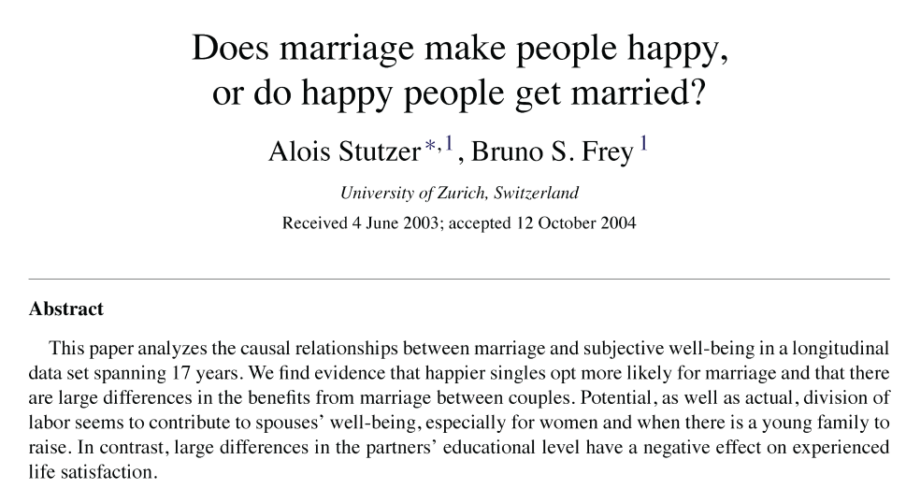
Example of Selection Bias: Marriage and Happiness
Notes:
Cover this example if you have time.

Slide 97
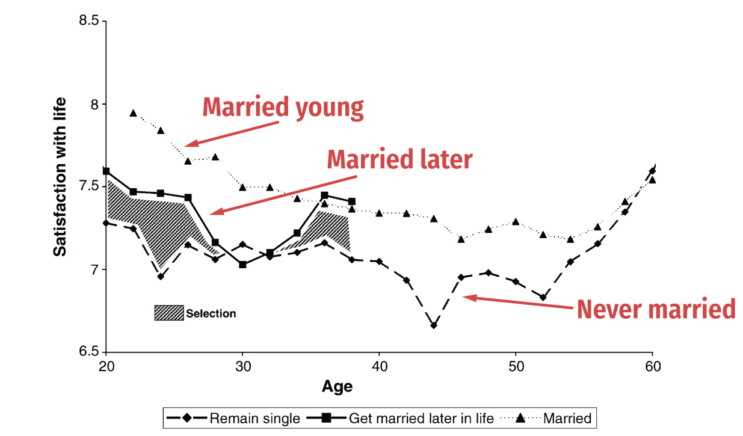
Example of Selection Bias: Marriage and Happiness
Notes:
Cover this example if you have time. Comparison between age of marriage and reported happiness (note: think about construct validity here too, with happiness scores). The selection is those choosing to be married in time sample, but could there be other threats?

Slide 98
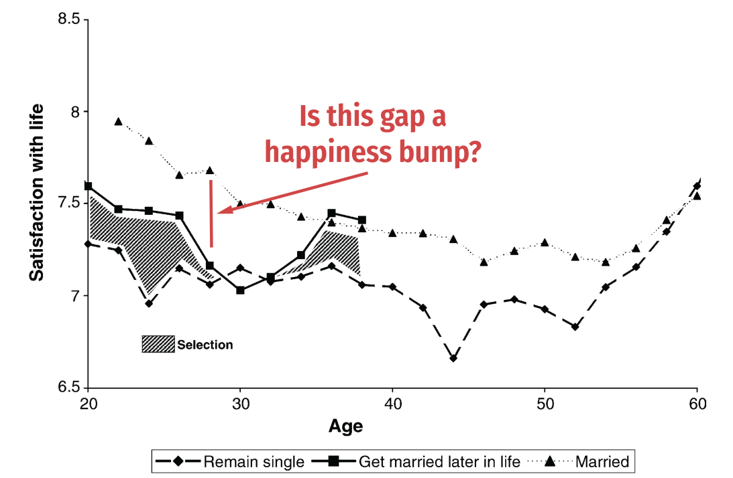
Example of Selection Bias: Marriage and Happiness
Notes:
What threats are there to this (selection into early marriage, etc.)

Slide 99
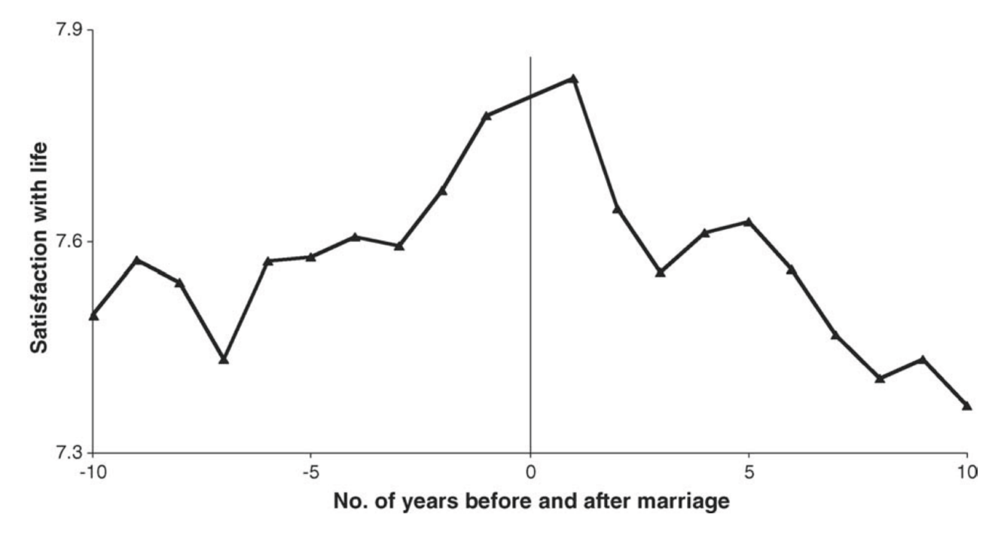
Example of Selection Bias: Marriage and Happiness
Notes:
The authors tried to compare based on relative years around marriage, but look: happiness ticks up before marriage – so it can’t be from marriage! Of course, there are problems with this design (end of semester).
We will talk about more internal validity threats next time as well.

Slide 100
What do my results mean?
Types of causal validity
Construct validity: are we measuring what we want to measure?
Statistical validity: are your statistics correct?
Internal validity: are your mechanisms correct?
External validity: are your findings generalizable?
Are your results a fluke of a limited sample?
Notes:
We’ll talk about more threats to internal validity throughout the course, particularly next time. If you want to think about multiple threats to IV, just think about nutrition research (they’re everywhere!)

Slide 101

Example of External Validity
Notes:
Um what? Don’t trust the headlines, or the lay media.

Slide 102

Example of Selection Bias: Marriage and Happiness
Notes:
True story: this was a study published about mice! But read the text summarizing the study.

Slide 103

What do my results mean?
Types of causal validity
Construct validity: are we measuring what we want to measure?
Statistical validity: are your statistics correct?
Internal validity: are your mechanisms correct?
External validity: are your findings generalizable?
Are your results a fluke of a limited sample?
Does your data match the population?
Notes:
Particularly of concern with surveys or even clinical trials

Slide 104
Summary
Regression is a very powerful tool (use it well)
Importance of controlling for colliders/covariates
Inference and uncertainty of a regression
Interpreting regression coefficients and tables
Presenting your results
Next time: getting fancier with regression
Types of variables you can use
Interaction effects
(Some) Nonlinear models

Slide 105
Other Options with Regressions
There are multiple other things that can be done with a regression
Regression is a very flexible tool
In class, we’ll cover:
Options for variables (scaling & transformations)
Interactions
Nonlinear effects which are linear in parameters
Later, we’ll cover more nonlinear regression options:
Binary outcome variables (probit/logit)
General nonparametric approaches

Slide 106
Variable Selection: Transformations

Slide 107
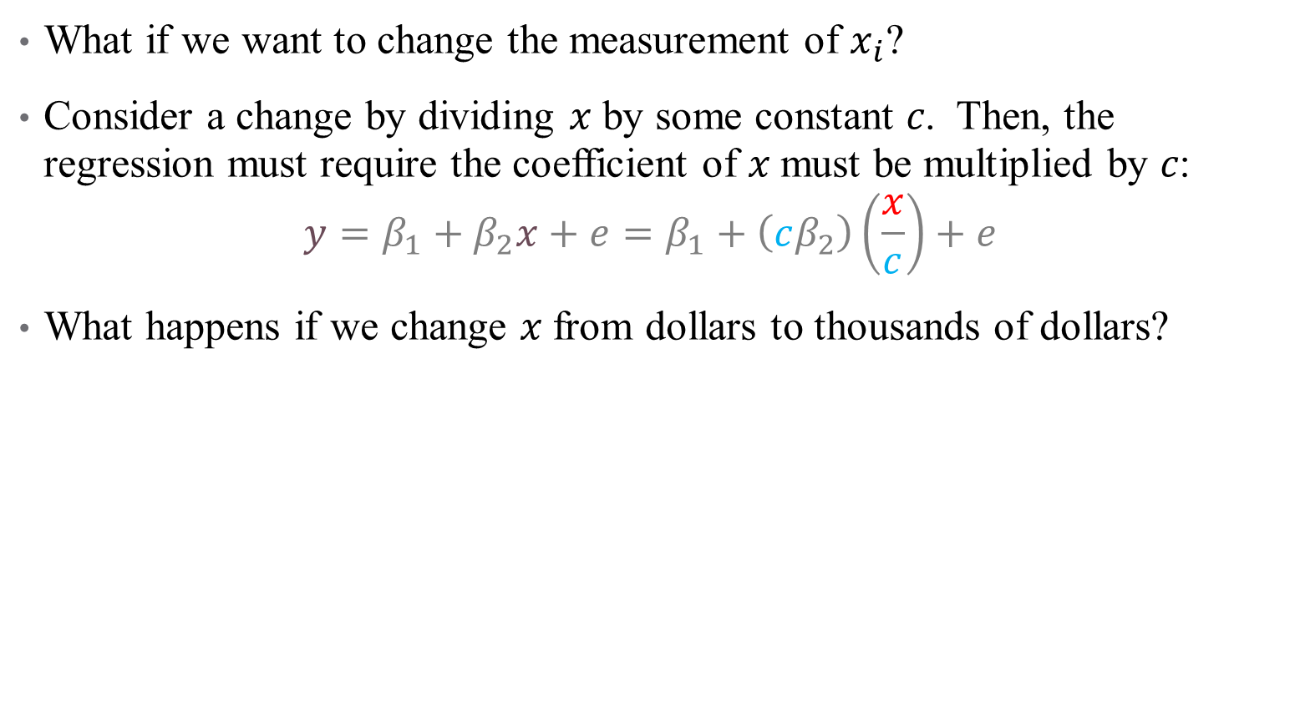
Scaling Regressors
What if we want to change the measurement of $x_{i}$?
Consider a change by dividing 𝑥 by some constant 𝑐. Then, the regression must require the coefficient of 𝑥 must be multiplied by 𝑐:
$$y=β_{1}+β_{2}x+e=β_{1}+\left(cβ_{2}\right)\left(\frac{x}{c}\right)+e$$
What happens if we change 𝑥 from dollars to thousands of dollars?
Notes:
This is directly related to the idea that if beta is the ME of 1, then the ME of 100 is 100*beta. May come in useful for your homework assignment – feel free to rescale variables as desired.

Slide 108
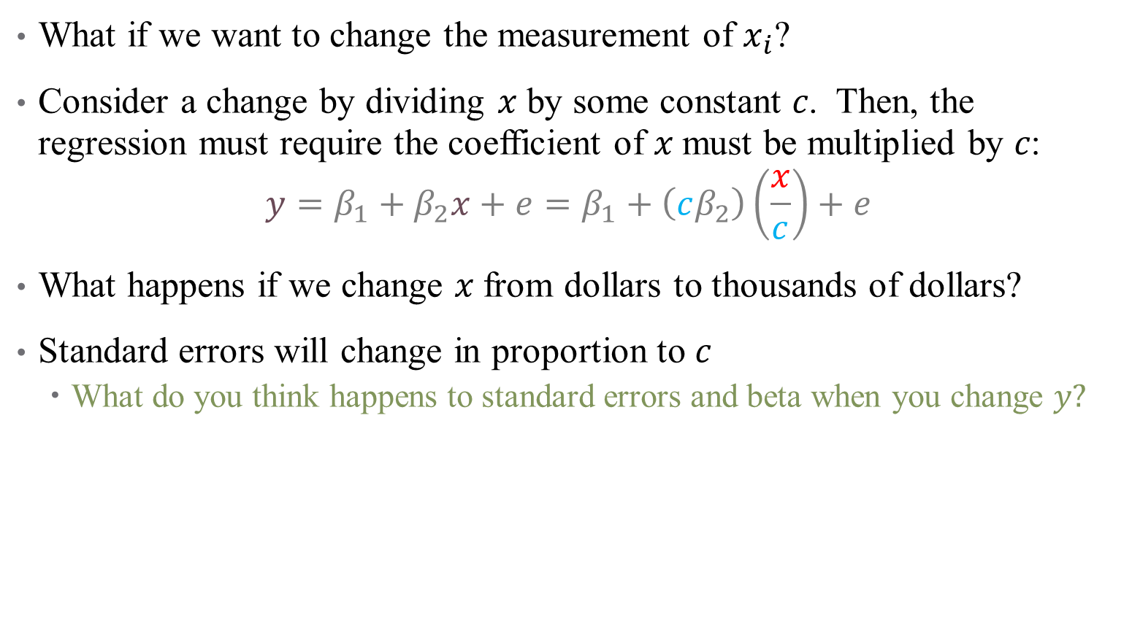
Scaling Regressors
What if we want to change the measurement of $x_{i}$?
Consider a change by dividing 𝑥 by some constant 𝑐. Then, the regression must require the coefficient of 𝑥 must be multiplied by 𝑐:
$$y=β_{1}+β_{2}x+e=β_{1}+\left(cβ_{2}\right)\left(\frac{x}{c}\right)+e$$
What happens if we change 𝑥 from dollars to thousands of dollars?
Standard errors will change in proportion to $c$
What do you think happens to standard errors and beta when you change $y?$
Notes:
They all change by the same amount

Slide 109
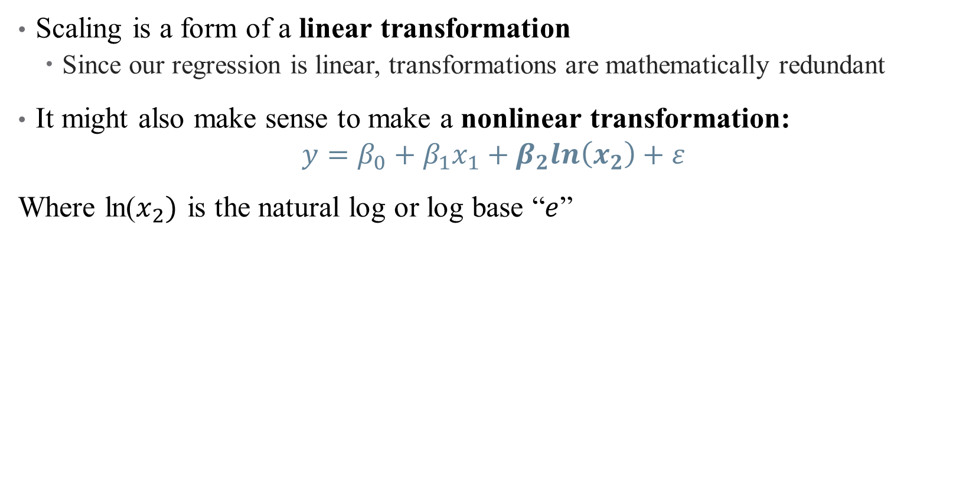
Nonlinear Transformations
Scaling is a form of a linear transformation
Since our regression is linear, transformations are mathematically redundant
It might also make sense to make a nonlinear transformation:
$$y=β_{0}+β_{1}x_{1}+β_{2}ln\left(x_{2}\right)+ε$$
Where ln($x_{2})$ is the natural log or log base “$e$”

Slide 110
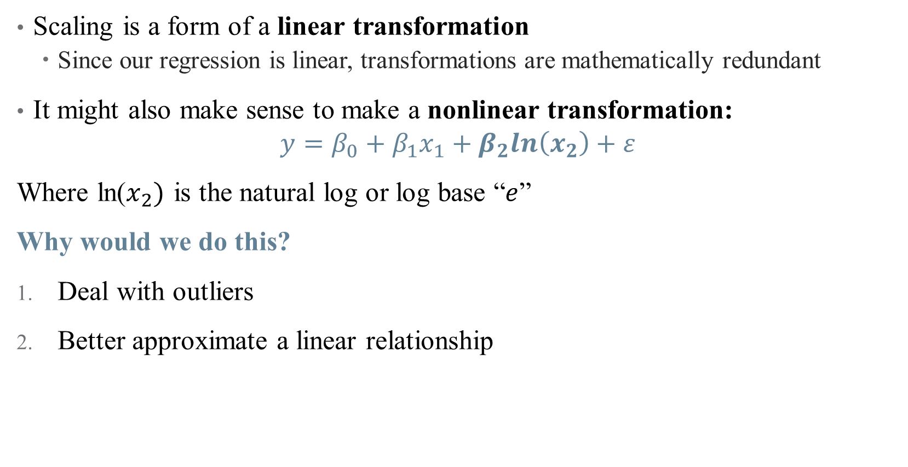
Nonlinear Transformations
Scaling is a form of a linear transformation
Since our regression is linear, transformations are mathematically redundant
It might also make sense to make a nonlinear transformation:
$$y=β_{0}+β_{1}x_{1}+β_{2}ln\left(x_{2}\right)+ε$$
Where ln($x_{2})$ is the natural log or log base “$e$”
Why would we do this?
Deal with outliers
Better approximate a linear relationship

Slide 111
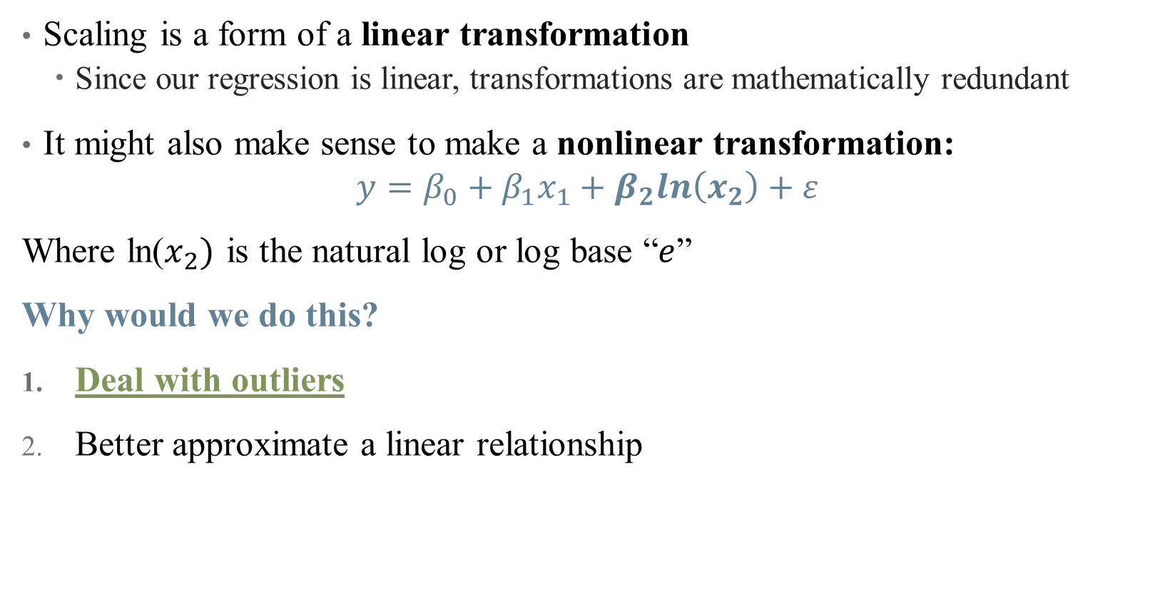
Nonlinear Transformations
Scaling is a form of a linear transformation
Since our regression is linear, transformations are mathematically redundant
It might also make sense to make a nonlinear transformation:
$$y=β_{0}+β_{1}x_{1}+β_{2}ln\left(x_{2}\right)+ε$$
Where ln($x_{2})$ is the natural log or log base “$e$”
Why would we do this?
Deal with outliers
Better approximate a linear relationship

Slide 112
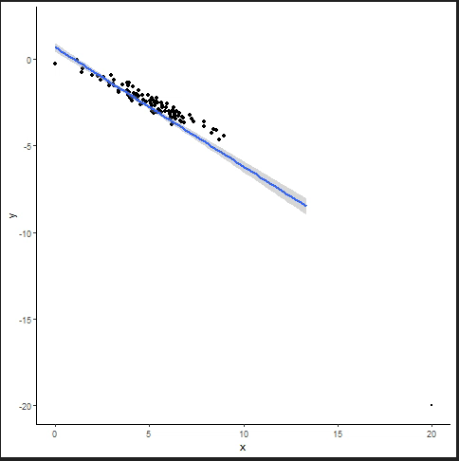
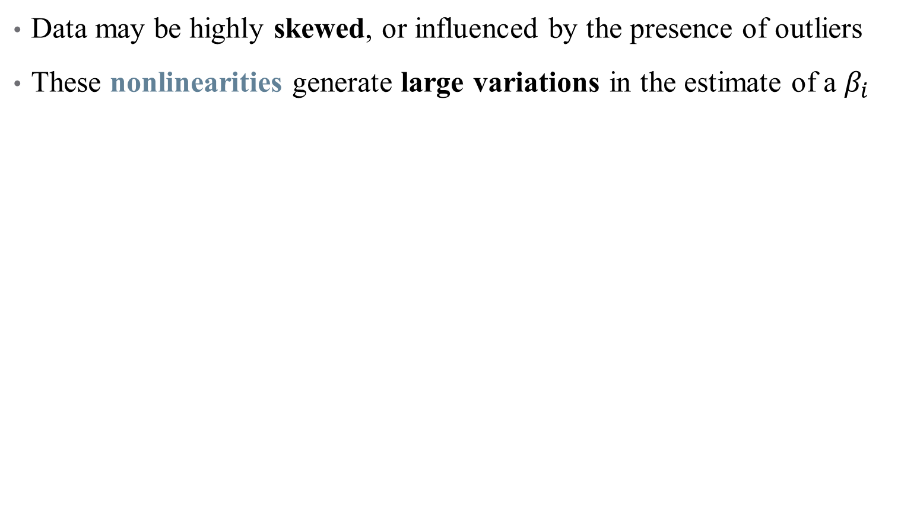
Nonlinear Transformations: Outliers
Data may be highly skewed, or influenced by the presence of outliers
These nonlinearities generate large variations in the estimate of a $β_{i}$
Notes:
Example: income distribution

Slide 113
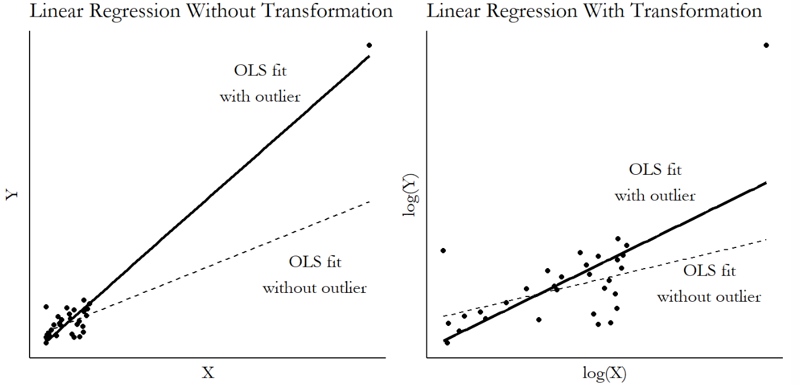
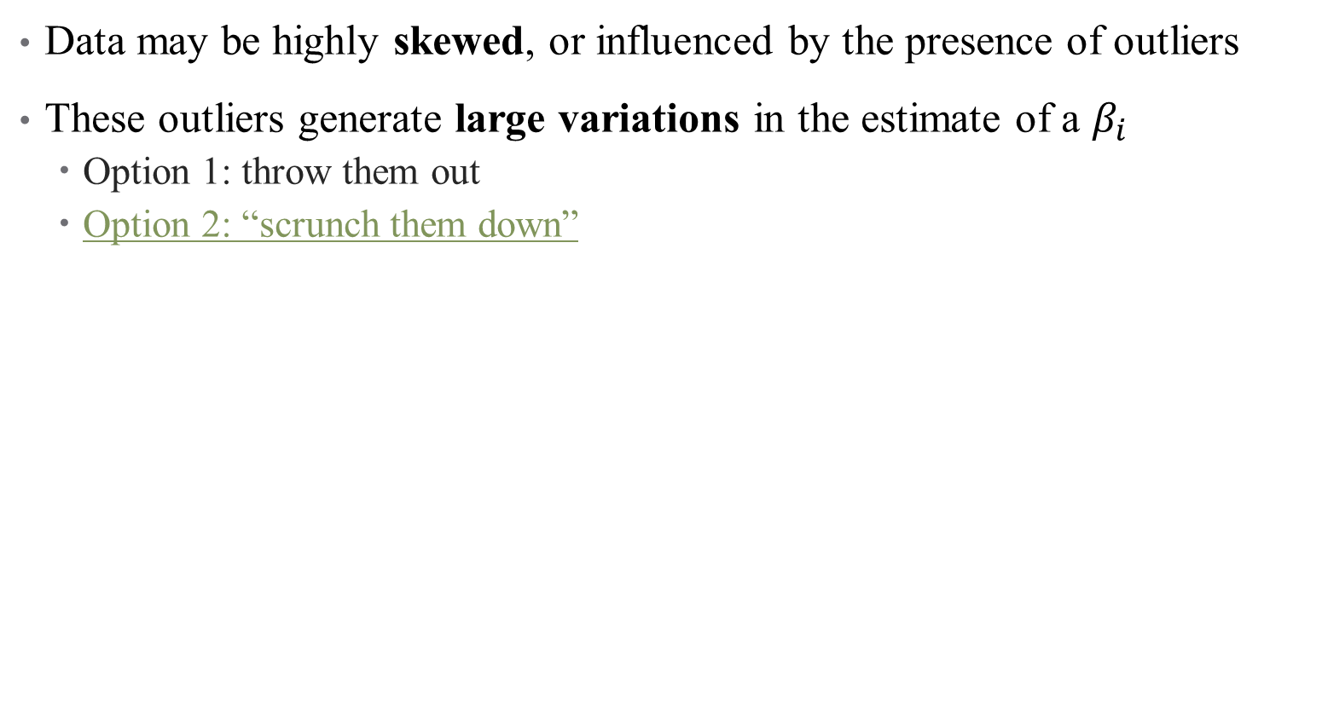
Nonlinear Transformations: Outliers
Data may be highly skewed, or influenced by the presence of outliers
These outliers generate large variations in the estimate of a $β_{i}$
Option 1: throw them out
Option 2: “scrunch them down”
Notes:
What does it mean to get selective with your data? That’s a bold move.

Slide 114
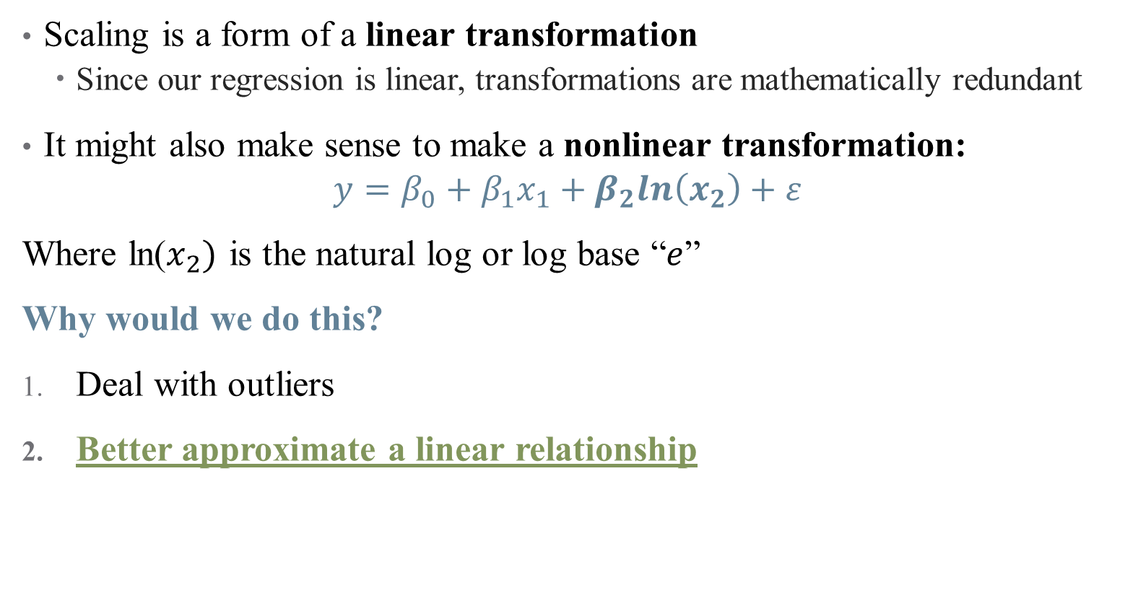
Nonlinear Transformations
Scaling is a form of a linear transformation
Since our regression is linear, transformations are mathematically redundant
It might also make sense to make a nonlinear transformation:
$$y=β_{0}+β_{1}x_{1}+β_{2}ln\left(x_{2}\right)+ε$$
Where ln($x_{2})$ is the natural log or log base “$e$”
Why would we do this?
Deal with outliers
Better approximate a linear relationship
Notes:
This is all about interpretation – what does it mean to interpret a single marginal effect if the distribution is wonky? Change from 10000 to 20000 annually versus change from 200000 to 210000

Slide 115
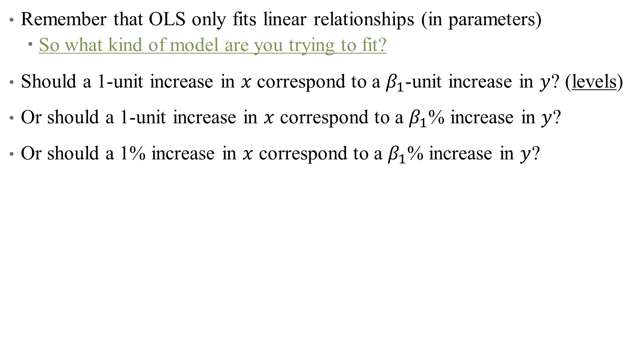
Nonlinear Transformations: Achieving Linearity
Remember that OLS only fits linear relationships (in parameters)
So what kind of model are you trying to fit?
Should a 1-unit increase in $x$ correspond to a $β_{1}$-unit increase in $y$? (levels)
Or should a 1-unit increase in $x$ correspond to a $β_{1}$% increase in $y$?
Or should a 1% increase in $x$ correspond to a $β_{1}$% increase in $y$?

Slide 116
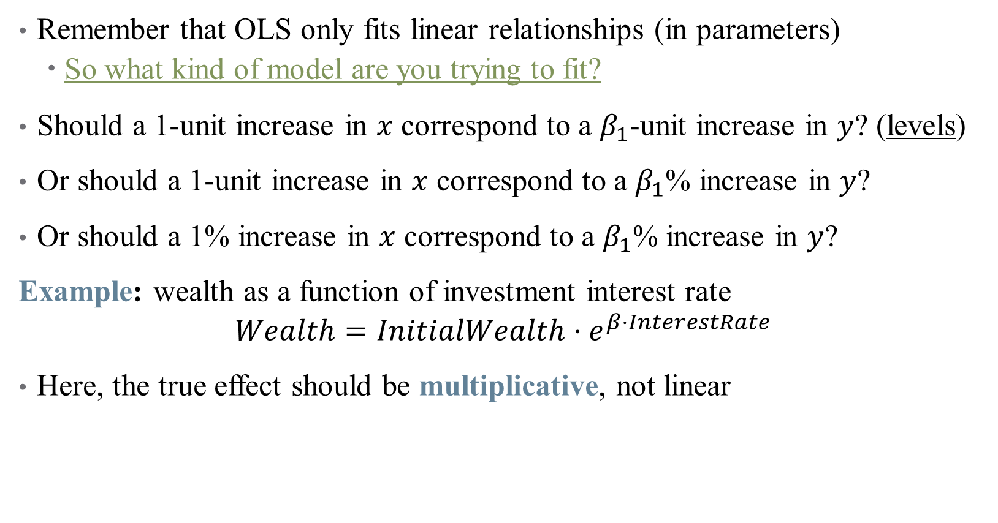
Nonlinear Transformations: Achieving Linearity
Remember that OLS only fits linear relationships (in parameters)
So what kind of model are you trying to fit?
Should a 1-unit increase in $x$ correspond to a $β_{1}$-unit increase in $y$? (levels)
Or should a 1-unit increase in $x$ correspond to a $β_{1}$% increase in $y$?
Or should a 1% increase in $x$ correspond to a $β_{1}$% increase in $y$?
Example: wealth as a function of investment interest rate
$$Wealth=InitialWealth⋅e^{β⋅InterestRate}$$
Here, the true effect should be multiplicative, not linear
Notes:
How to get this in a regression? Use the natural log! Do this on the board.

Slide 117
What kinds of transformations exist?
See “The Effect” for a (more) exhaustive list (pg. 214)
Natural Log – tried and true
But, recall that ln(0) is undefined – what if we have zero-valued data?

Slide 118
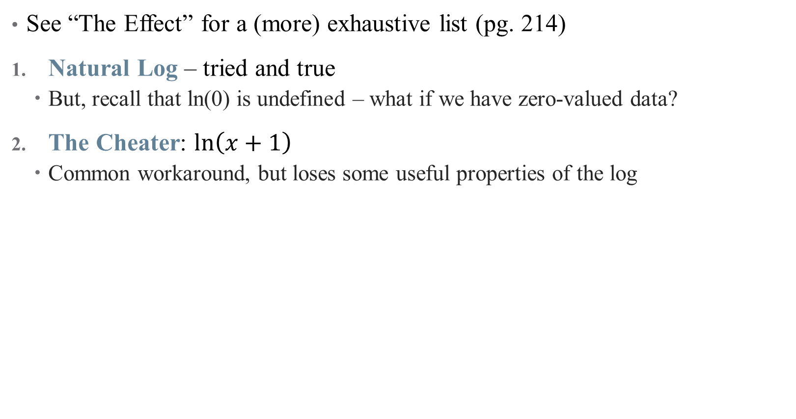
What kinds of transformations exist?
See “The Effect” for a (more) exhaustive list (pg. 214)
Natural Log – tried and true
But, recall that ln(0) is undefined – what if we have zero-valued data?
The Cheater: $ln\left(x+1\right)$
Common workaround, but loses some useful properties of the log
Notes:
If x is large, log(x+1) \approx. log(x). So this works for like health spending or income data, and is defined for 0s. Hence, percentages don’t really work for small x.

Slide 119
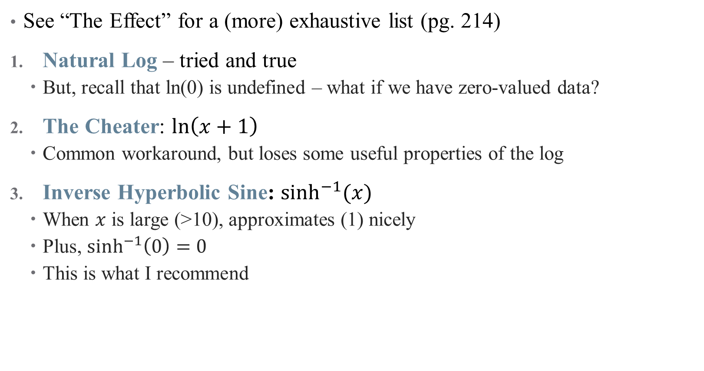
What kinds of transformations exist?
See “The Effect” for a (more) exhaustive list (pg. 214)
Natural Log – tried and true
But, recall that ln(0) is undefined – what if we have zero-valued data?
The Cheater: $ln\left(x+1\right)$
Common workaround, but loses some useful properties of the log
Inverse Hyperbolic Sine: $\sinh^{−1}{(x)}$
When $x$ is large (>10), approximates (1) nicely
Plus, $\sinh^{−1}\left(0\right)=0$
This is what I recommend
Notes:
This is the hipster one – do it and you’re cool. Can also handle negative numbers if you need

Slide 120
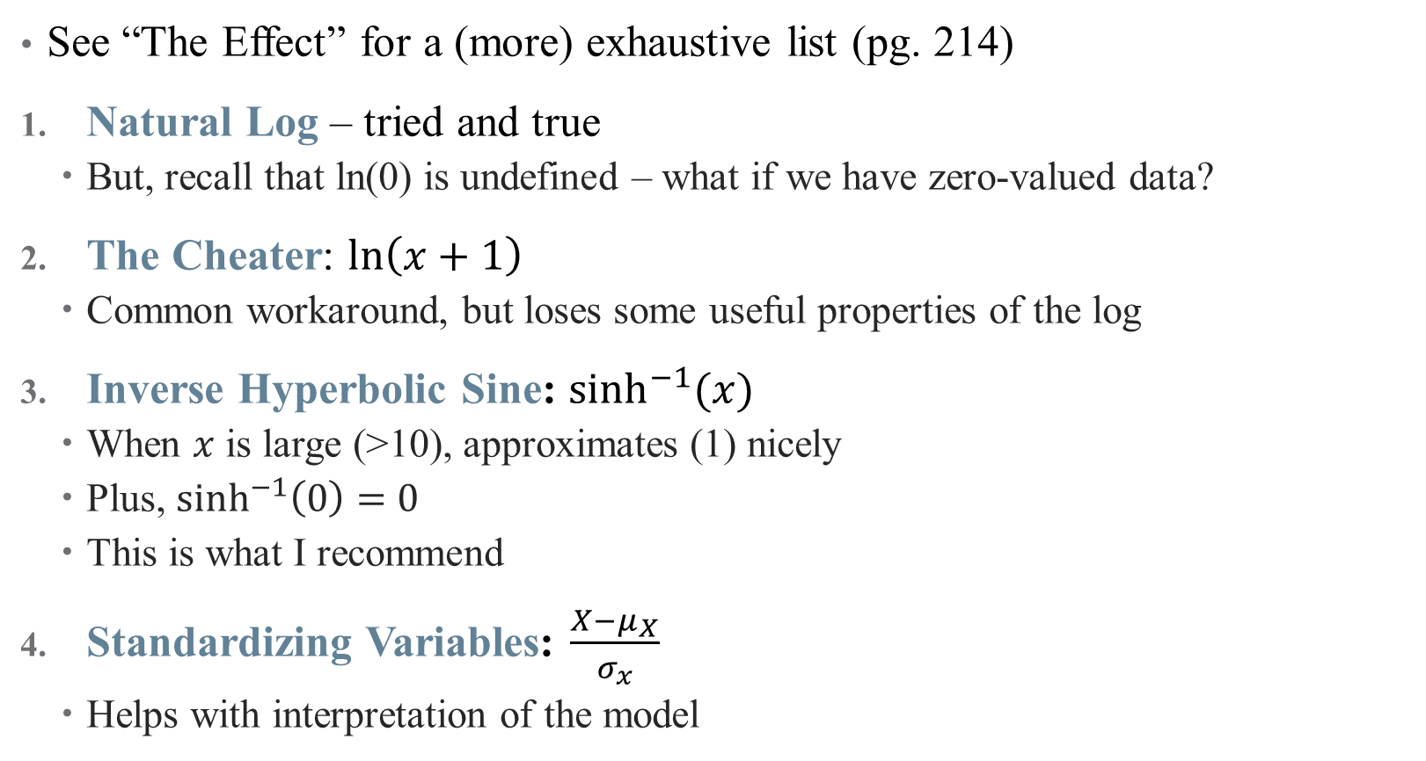
What kinds of transformations exist?
See “The Effect” for a (more) exhaustive list (pg. 214)
Natural Log – tried and true
But, recall that ln(0) is undefined – what if we have zero-valued data?
The Cheater: $ln\left(x+1\right)$
Common workaround, but loses some useful properties of the log
Inverse Hyperbolic Sine: $\sinh^{−1}{(x)}$
When $x$ is large (>10), approximates (1) nicely
Plus, $\sinh^{−1}\left(0\right)=0$
This is what I recommend
Standardizing Variables: $\frac{X−μ_{X}}{σ_{x}}$
Helps with interpretation of the model
Notes:
This is a common practice if the units are already weird (e.g., points on a happiness scale), and moves to more data-driven units. (another not shown is square root)

Slide 121
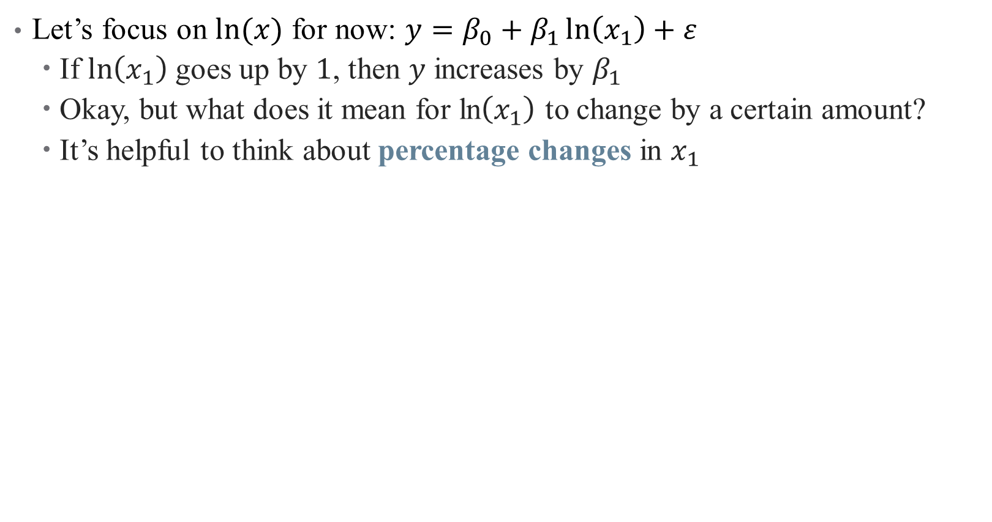
How to interpret coefficients on transformed variables?
Let’s focus on $ln⁡(x)$ for now: $y=β_{0}+β_{1}\ln\left(x_{1}\right)+ε$
If $\ln\left(x_{1}\right)$ goes up by $1$, then $y$ increases by $β_{1}$
Okay, but what does it mean for ln$\left(x_{1}\right)$ to change by a certain amount?
It’s helpful to think about percentage changes in $x_{1}$

Slide 122
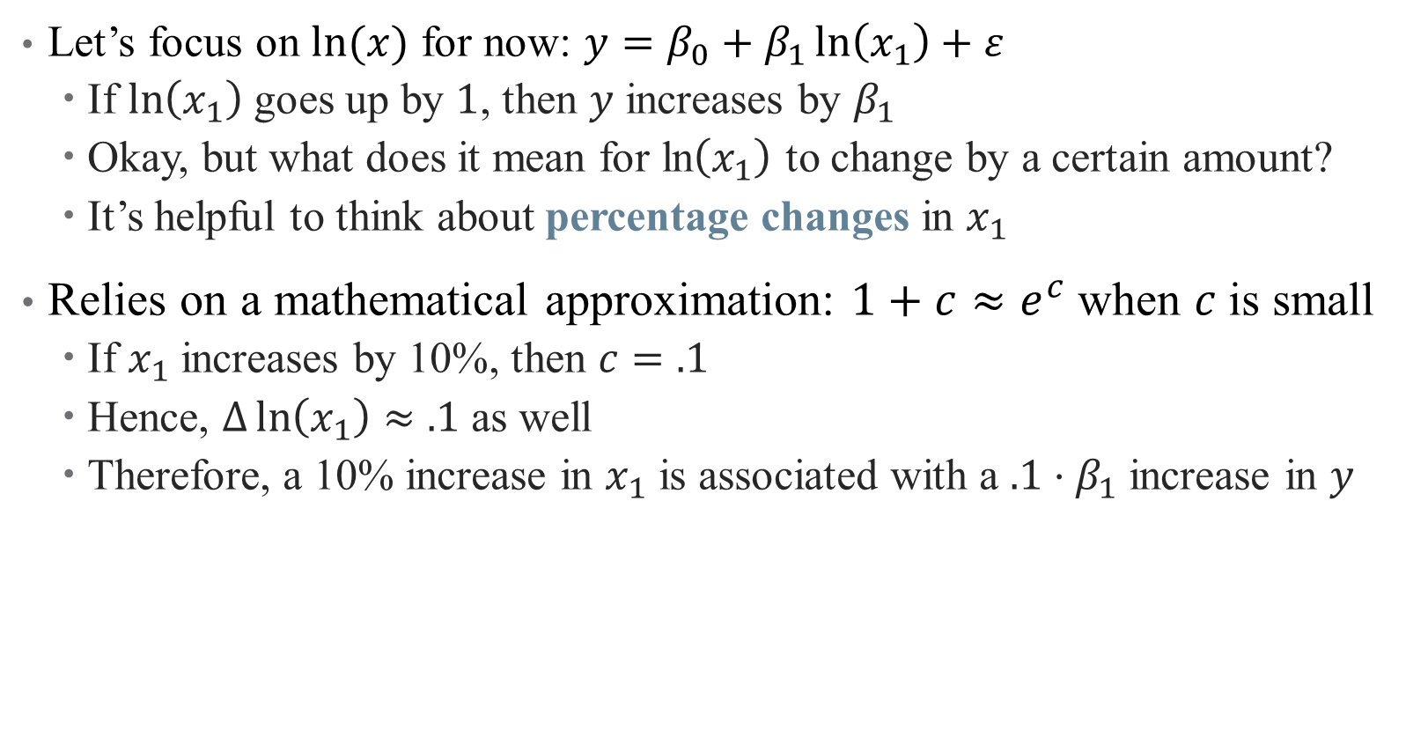
How to interpret coefficients on transformed variables?
Let’s focus on $ln⁡(x)$ for now: $y=β_{0}+β_{1}\ln\left(x_{1}\right)+ε$
If $\ln\left(x_{1}\right)$ goes up by $1$, then $y$ increases by $β_{1}$
Okay, but what does it mean for ln$\left(x_{1}\right)$ to change by a certain amount?
It’s helpful to think about percentage changes in $x_{1}$
Relies on a mathematical approximation: $1+c≈e^{c}$when $c$is small
If $x_{1}$ increases by 10%, then $c=.1$
Hence, $Δ\ln\left(x_{1}\right)≈.1$ as well
Therefore, a 10% increase in $x_{1}$ is associated with a $.1⋅β_{1}$ increase in $y$

Slide 123
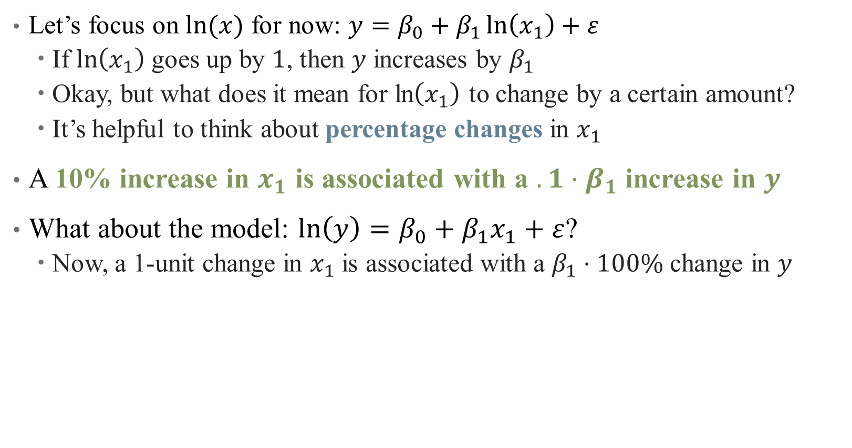
How to interpret coefficients on transformed variables?
Let’s focus on $ln⁡(x)$ for now: $y=β_{0}+β_{1}\ln\left(x_{1}\right)+ε$
If $\ln\left(x_{1}\right)$ goes up by $1$, then $y$ increases by $β_{1}$
Okay, but what does it mean for ln$\left(x_{1}\right)$ to change by a certain amount?
It’s helpful to think about percentage changes in $x_{1}$
A 10% increase in $x_{1}$ is associated with a $.1⋅β_{1}$ increase in $y$
What about the model: $ln\left(y\right)=β_{0}+β_{1}x_{1}+ε$?
Now, a 1-unit change in $x_{1}$ is associated with a $β_{1}⋅100\%$ change in $y$
Notes:
Just the same as before, but one of the variables is in percent and one is in levels – just depends which one you want

Slide 124
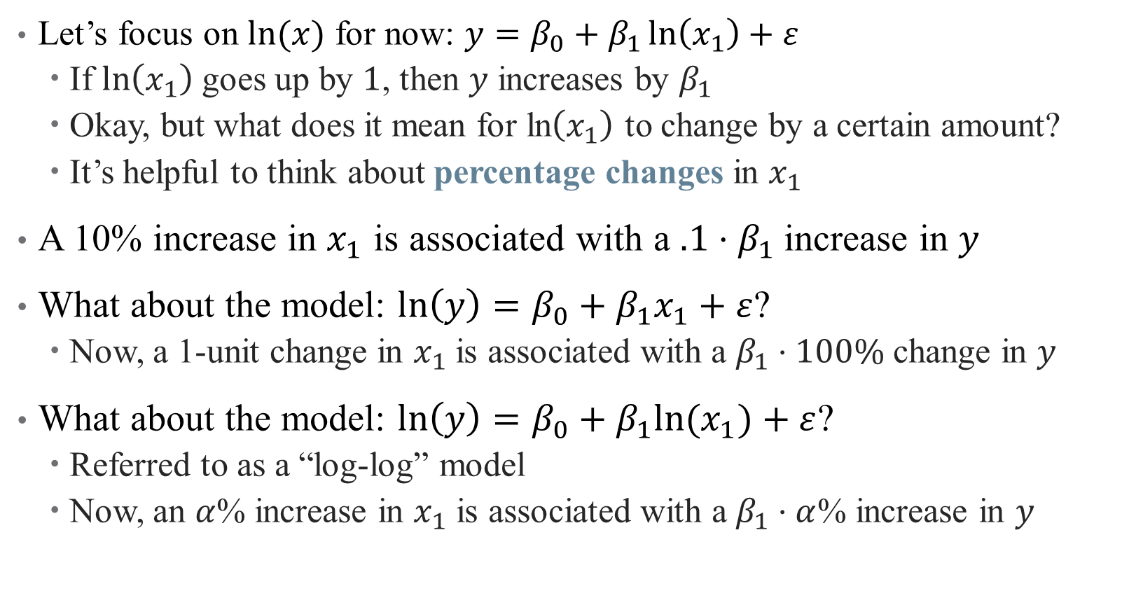
How to interpret coefficients on transformed variables?
Let’s focus on $ln⁡(x)$ for now: $y=β_{0}+β_{1}\ln\left(x_{1}\right)+ε$
If $\ln\left(x_{1}\right)$ goes up by $1$, then $y$ increases by $β_{1}$
Okay, but what does it mean for ln$\left(x_{1}\right)$ to change by a certain amount?
It’s helpful to think about percentage changes in $x_{1}$
A 10% increase in $x_{1}$ is associated with a $.1⋅β_{1}$ increase in $y$
What about the model: $ln\left(y\right)=β_{0}+β_{1}x_{1}+ε$?
Now, a 1-unit change in $x_{1}$ is associated with a $β_{1}⋅100\%$ change in $y$
What about the model: $ln\left(y\right)=β_{0}+β_{1}{ln⁡(x}_{1})+ε$?
Referred to as a “log-log” model
Now, an $α$% increase in $x_{1}$ is associated with a $β_{1}⋅α$% increase in $y$
Notes:
This is the version where both are in percentages.

Slide 125
Interaction Effects

Slide 126

What is an Interaction?
Suppose we want to know the effect of $X$ on $Y$ specific to groups $Z$
Notes:
Example: what is the effect of radiology on survival? Well that depends on different groups of cancer patients

Slide 127

What is an Interaction?
Suppose we want to know the effect of $X$ on $Y$ specific to groups $Z$
We want to flexibly model how a relationship between two variables may depend on the levels of a third
$$Y=β_{0}+β_{1}X+β_{2}Z+β_{3}\left(X⋅Z\right)+ε$$
Notes:
We add what’s called an interaction term – here, X is the effect of radiation, and Z is an indicator variable for different type of cancer. What do each of the coefficients mean?

Slide 128

What is an Interaction?
Suppose we want to know the effect of $X$ on $Y$ specific to groups $Z$
We want to flexibly model how a relationship between two variables may depend on the levels of a third
$$Y=β_{0}+β_{1}X+β_{2}Z+β_{3}\left(X⋅Z\right)+ε$$
Main question: how do we interpret interaction terms?
Notes:
We can interpret coefs 1 and 2 easily, what about 3?

Slide 129
Discrete Regressors
Notes:
This is from last time – the impact of including a dummy is an intercept shift

Slide 130

Discrete Regressors
Notes:
An interaction is a change in slope for two groups – here, we estimate happiness as a function of life expectancy * (latin America) to get separate slopes for each region

Slide 131

How do we Interpret Interaction Terms?
Example: risk adjustment (predicting health costs)
$cost_{i}=β_{0}+β_{1}cancers_{i}+β_{2}male_{i}+β_{3}cancers_{i}∗male_{i}+\vec{γ}Z_{i}+ε_{i}$
What is the effect of cancer on predicted costs?
To find this, just take the derivative:
$$\frac{∂cost_{i}}{∂cancers_{i}}=β_{1}+β_{3}∗male_{i}$$
Notes:
Interaction terms are everywhere in risk adjustment!

Slide 132

How do we Interpret Interaction Terms?
Example: risk adjustment (predicting health costs)
$cost_{i}=β_{0}+β_{1}cancers_{i}+β_{2}male_{i}+β_{3}cancers_{i}∗male_{i}+\vec{γ}Z_{i}+ε_{i}$
What is the effect of cancer on predicted costs?
To find this, just take the derivative:
$$\frac{∂cost_{i}}{∂cancers_{i}}=β_{1}+β_{3}∗male_{i}$$
Hence, predictions are different across sexes:
For females: $β_{1}$
For males: $β_{1}+β_{3}$
$β_{3}$ tells you the differential marginal cost of cancer for males
Notes:
Not just a level shift, but different margin here.

Slide 133

What about Continuous Interactions?
Example: risk adjustment (predicting health costs)
$cost_{i}=β_{0}+β_{1}BMI_{i}+β_{2}Age_{i}+β_{3}Age_{i}∗BMI_{i}+\vec{γ}Z_{i}+ε_{i}$
What is the effect of BMI on predicted costs?
To find this, just take the derivative:
$$\frac{∂cost_{i}}{∂BMI_{i}}=β_{1}+β_{3}∗Age_{i}$$
Now, interpretation is harder:
As BMI increases, costs are expected to change by $β_{1}$
But as age increases, effect of BMI is also changing by $β_{3}$
Notes:
Typically, interactions make more sense when one of the variables is categorical, but you can estimate this. For interpretation, you would generally “pin down” a comparison (e.g., say the change in marginal effect of BMI on costs for a 50-yo to a 60-yo)

Slide 134

What about Continuous Interactions?
Example: risk adjustment (predicting health costs)
$cost_{i}=β_{0}+β_{1}BMI_{i}+β_{2}Age_{i}+β_{3}Age_{i}∗BMI_{i}+\vec{γ}Z_{i}+ε_{i}$
What is the effect of BMI on predicted costs?
To find this, just take the derivative:
$$\frac{∂cost_{i}}{∂BMI_{i}}=β_{1}+β_{3}∗Age_{i}$$
Now, interpretation is harder:
As BMI increases, costs are expected to change by $β_{1}$
But as age increases, effect of BMI is also changing by $β_{3}$
$β_{3}$ tells you how much stronger the effect of BMI on costs gets as a patient gets older

Slide 135

Interactions in Practice
Always include all pieces of an interaction in the full model
Much harder to interpret
Have a strong theoretical reason to justify inclusion
Too easy to get false positives
Effects are generally noisy
You’re exploiting variation across 2 noisy variables already
Will need large sample size
Notes:
Note on 1 – R will mostly do this for you, but don’t leave it up to chance. You have to do this to not keep open back doors (DAG) Note on 2: if we let the data do whatever it wants, we’ll find results that don’t mean much.

Slide 136

Interactions have Power Issues!

Slide 137
Nonlinear Models (pt. 1)

Slide 138

Nonlinearities
Sometimes, a linear model isn’t enough (even after transformations)

Slide 139
Could we transform this data?
When data can be transformed to accommodate linear relationships, do it
Otherwise, add polynomial terms!

Slide 140

Choosing a Functional Form
OLS can accommodate regressions of the form:
$$y=β_{0}+β_{1}x+β_{2}x^{2}+β_{3}x^{3}+ …+\vec{γ}Z+ε$$
Still linear in parameters
As in interaction terms, never omit an intermediate power
That is, don’t add a cubic term without a quadratic one
Notes:
Remember, OLS is linear in parameters (not necessarily in data) – it just depends how you plan to interpret the parameters of the funky data you’re giving OLS

Slide 141

Choosing a Functional Form
OLS can accommodate regressions of the form:
$$y=β_{0}+β_{1}x+β_{2}x^{2}+β_{3}x^{3}+ …+\vec{γ}Z+ε$$
Still linear in parameters
As in interaction terms, never omit an intermediate power
That is, don’t add a cubic term without a quadratic one
Changing functional forms may yield a better fit, but also changes interpretation of the coefficients.

Slide 142

How do we Interpret Coefficients?
OLS can accommodate regressions of the form:
$$y=β_{0}+β_{1}x+β_{2}x^{2}+β_{3}x^{3}+ …+\vec{γ}Z+ε$$
Changing functional forms may yield a better fit, but also changes interpretation of the coefficients.
$$\frac{∂y}{∂x}=β_{1}+2β_{2}⋅x+3β_{3}⋅x^{2}+ …$$
Now, marginal effects depend on levels of $x$
Notes:
So what exactly do you do here? Have to generally pick a level of x (mean, for example) for this to make sense.

Slide 143

How do we Interpret Coefficients?
OLS can accommodate regressions of the form:
$$y=β_{0}+β_{1}x+β_{2}x^{2}+β_{3}x^{3}+ …+\vec{γ}Z+ε$$
Changing functional forms may yield a better fit, but also changes interpretation of the coefficients.
$$\frac{∂y}{∂x}=β_{1}+2β_{2}⋅x+3β_{3}⋅x^{2}+ …$$
Now, marginal effects depend on levels of $x$
Another caution: overfitting
How much randomness in the data do we want to add to our model?
How much complication in our marginal effects are we willing to tolerate?
See discussion on LASSO, etc. for automated inclusion

Slide 144
Getting the “Right” Standard Errors

Slide 145

Standard Errors
Even after ensuring that the model is correctly specified, we need an idea of how precise our estimates are
Recall that $se(\hat{β_{1}})$ tells us something about sampling distribution:
Range of plausible estimates,
Confidence intervals,
Statistical significance
Eliminating certain DGPs

Slide 146

Standard Errors
Even after ensuring that the model is correctly specified, we need an idea of how precise our estimates are
Recall that $se(\hat{β_{1}})$ tells us something about sampling distribution:
Range of plausible estimates,
Confidence intervals,
Statistical significance
Eliminating certain DGPs
But the assumptions we made about $ε$ to get $se(\hat{β_{1})}$ aren’t necessarily good ones!
Key assumption: $ε_{i}$ is independent and identically distributed (i.i.d.)

Slide 147

Are my error terms i.i.d.?
Autocorrelation: “Shock” of today is correlated with “shock” from yesterday
Notes:
This is less of a problem in our data, because we rarely use time series data (which is different from panel). We’ll come back to this a little next semester – takeaway is that beta is still unbiased and inconsistent, but we will tend to overestimate significance (we need to inflate our standard errors to account for correlation)

Slide 148


Are my error terms i.i.d.?
Heteroskedasticity: Variance of distribution depends on $x$
Notes:
This is a big one for us!

Slide 149

Are my error terms i.i.d.?
Autocorrelation: Today’s “shock” today is correlated with yesterday’s
Heteroskedasticity: Variance of distribution depends on $x$
Others: Correlation within groups, multiple testing, sampling errors, etc.
Failure of $ε$ to be i.i.d. means that $se\left(\hat{β_{1}}\right)≠\sqrt{\frac{σ^{2}}{var\left(x\right)n}}$
Notes:
Multiple testing – we’ve talked about this.

Slide 150

Are my error terms i.i.d.?
Autocorrelation: Today’s “shock” today is correlated with yesterday’s
Heteroskedasticity- and autocorrelation-consistent (HAC) standard errors
Newey-West estimator, adjusts $se(\hat{β_{1}})$ based on lagged variable outcomes
Heteroskedasticity: Variance of distribution depends on $x$
Others: Correlation within groups, multiple testing, sampling errors, etc.
Failure of $ε$ to be i.i.d. means that $se\left(\hat{β_{1}}\right)≠\sqrt{\frac{σ^{2}}{var\left(x\right)n}}$

Slide 151

Are my error terms i.i.d.?
Autocorrelation: Today’s “shock” today is correlated with yesterday’s
Heteroskedasticity- and autocorrelation-consistent (HAC) standard errors
Newey-West estimator, adjusts $se(\hat{β_{1}})$ based on lagged variable outcomes
Heteroskedasticity: Variance of distribution depends on $x$
Heteroskedasticity-robust sandwich estimators
Huber-White estimator, adjusts $se(\hat{β_{1}})$ with weights for observations with large residuals
Others: Correlation within groups, multiple testing, sampling errors
Failure of $ε$ to be i.i.d. means that $se\left(\hat{β_{1}}\right)≠\sqrt{\frac{σ^{2}}{var\left(x\right)n}}$

Slide 152

Are my error terms i.i.d.?
Autocorrelation: Today’s “shock” today is correlated with yesterday’s
Heteroskedasticity- and autocorrelation-consistent (HAC) standard errors
Newey-West estimator, adjusts $se(\hat{β_{1}})$ based on lagged variable outcomes
Heteroskedasticity: Variance of distribution depends on $x$
Heteroskedasticity-robust sandwich estimators
Huber-White estimator, adjusts $se(\hat{β_{1}})$ with weights for observations with large residuals
Others: Correlation within groups, multiple testing, sampling errors
Clustered standard errors
Bootstrapped standard errors
Failure of $ε$ to be i.i.d. means that $se\left(\hat{β_{1}}\right)≠\sqrt{\frac{σ^{2}}{var\left(x\right)n}}$
Notes:
We’ll introduce robust errors – what we will usually use more is clustered robust.

Slide 153
Clustered Standard Errors
Errors might be correlated in a hierarchical structure
Example: effect of a health intervention across villages in rural area?
Different village structures mean people in same village have similar “shocks”
Errors might be correlated within villages
Notes:
Once again, we need to inflate our Ses to deal with this.

Slide 154

Clustered Standard Errors
Errors might be correlated in a hierarchical structure
Example: effect of a health intervention across villages in rural area?
Different village structures mean people in same village have similar “shocks”
Errors might be correlated within villages
There is a sandwich estimator that lets $X$ interact w/ other $Xs$ in the same group
Flexibly handles clustered standard errors!
But need to be careful how you choose the clusters
Good rule to remember: cluster at the level of the treatment
Notes:
Sandwich estimator is an econometrician’s fav thing.

Slide 155


Clustered Standard Errors
Notes:
When Should You Adjust Standard Errors for Clustering? Alberto Abadie, Susan Athey, Guido W. Imbens, and Jeffrey Wooldridge (metrics avengers)

Slide 156


Clustered Standard Errors
Notes:
How do you choose what to cluster?

Slide 157


Clustered Standard Errors
Notes:
Main takeaways – cluster at the highest level (e.g., state, not county), but carefully consider when you should cluster (a Type II error is just as bad as a Type I). One rule when you should cluster: fixed effects + treatment heterogeneity.

Slide 158

Bootstrapped Standard Errors
One of the most powerful tools in statistics!
If we want to learn something about the sampling distribution, why not just take a bunch of samples and see how our estimates vary?
These are very useful for estimating $se(\hat{β_{1}})$ in unusual cases!
A couple caveats
Needs large sample sizes to work well
Can’t completely handle autocorrelation

Slide 159
Bootstrapped Standard Errors
One of the most powerful tools in statistics!
Start with a data set with observations.
Randomly sample observations from that data set, allowing the same observation to be drawn more than once. This is a “bootstrap sample.”
Estimate our statistic of interest using the bootstrap sample.
Repeat steps 1-3 a whole bunch of times.
Look at the distribution of estimates from across all the times we repeated steps 1-3. The standard deviation of that distribution is the standard error of the estimate. The 2.5th and 97.5th percentiles show the 95% confidence interval, and so on.

Slide 160
Notes on Causality and Bias

Slide 161
Interpreting your results causally (One more time)
Remember that causality is hard!
Even after specifying your model, other things could go wrong:
Omitted Variables: missing data can bias your estimates
Measurement Error: mismeasured data can bias your estimates
Collinearity: correlation between variables can limit inferences
Notes:
We’re gonna touch on more threats to internal validity now.

Slide 162


Omitted Variables
Maybe you didn’t have data on a specific variable $z$
But if $Corr\left(x,z\right)≠0$, then omitting $z$ means $E\left(ε|x\right)≠0$
X
D
$$Y$$
R
Notes:
Leaving a back door open is a big problem in design-based inference. We’ve talked about this a lot, let’s look at some math real quick.

Slide 163


Omitted Variables
Maybe you didn’t have data on a specific variable $z$
But if $Corr\left(x,z\right)≠0$, then omitting $z$ means $E\left(ε|x\right)≠0$
This leads to bias in your estimates:
$$bias\left(\hat{β_{1}}\right)=𝔼\left[\hat{β_{1}}\right]−β_{1}$$
$$=Corr\left(x,z\right)\frac{σ_{ε}}{σ_{x}}$$

Slide 164

Measurement Error
Imprecision in your data also leads to biased estimates
Suppose that we don’t observe $x$, but rather $\tilde{x}=x+ζ$, where $ζ∼N(0,1)$
In this (classical) sense, this kind of error attenuates a regression coefficient
Notes:
Attenuation is a common refrain in published papers, but measurement error is more complicated than that!

Slide 165

Measurement Error
Imprecision in your data also leads to biased estimates
Suppose that we don’t observe $x$, but rather $\tilde{x}=x+ζ$, where $ζ∼N(0,1)$
In this (classical) sense, this kind of error attenuates a regression coefficient
However, nonclassical measurement error can lead to all kinds of problems
Examples of non-classical measurement error:
X is binary, so $Corr\left(ζ, x\right)≠0$by definition
Classification error (binary treatment variable)
Underreporting (income, crime, etc.)
Selection and open back doors!

Slide 166

Classical Measurement Error
Notes:
But when is it really classical?

Slide 167

Non-Classical Measurement Error: Examples
Notes:
Measurement error can be the result of an open back door, or selection – what health examples are there?

Slide 168

Non-Classical Measurement Error: Examples
Effect of hospital quality on patient outcomes $⇒$
What about the hospitals that attract the riskiest patients?
Which types of patients end up on ventilation?
Notes:
A whole literature on risk adjustment exists to (try to) solve this issue!

Slide 169

Collinearity and Causality
Some (explanatory) variables are highly correlated, complicating inference
Notes:
If I include age and height in a regression to close back doors, how do I know what is explained by age and what is explained by height? Here, this might not matter (we just care about “growth” as the causal pathway) but what if we could consider a policy that would randomly make people taller. Would that help health? Shrugh

Slide 170

Collinearity and Causality
Some (explanatory) variables are highly correlated, complicating inference
Inclusion of irrelevant variables tends to inflate the SEs for other estimates
What’s more, if variables are too highly correlated, their effects are indistinguishable
We’ve already run into the problem of perfect collinearity (where?)
A much harder problem is near-collinearity, where $\left|ρ\left(x_{1},x_{2}\right)\right|≈1$
This is especially problematic when we care about $β_{1}$or $β_{2}$, but not both
Notes:
Where have we seen perfect collinearity? Dummy variable trap?

Slide 171

Collinearity and Causality
Some (explanatory) variables are highly correlated, complicating inference
Inclusion of irrelevant variables tends to inflate the SEs for other estimates
What’s more, if variables are too highly correlated, their effects are indistinguishable
We’ve already run into the problem of perfect collinearity
A much harder problem is near-collinearity, where $\left|ρ\left(x_{1},x_{2}\right)\right|≈1$
This is especially problematic when we care about $β_{1}$or $β_{2}$, but not both
How to diagnose this?
Look at correlation matrix of independent variables
Think about which correlations mess with your DAG
Notes:
Think about how much it really matters – collinearity is a problem if it messes with the causal parameter of interest, but doesn’t matter if age and height are both controls.

